Slide 1
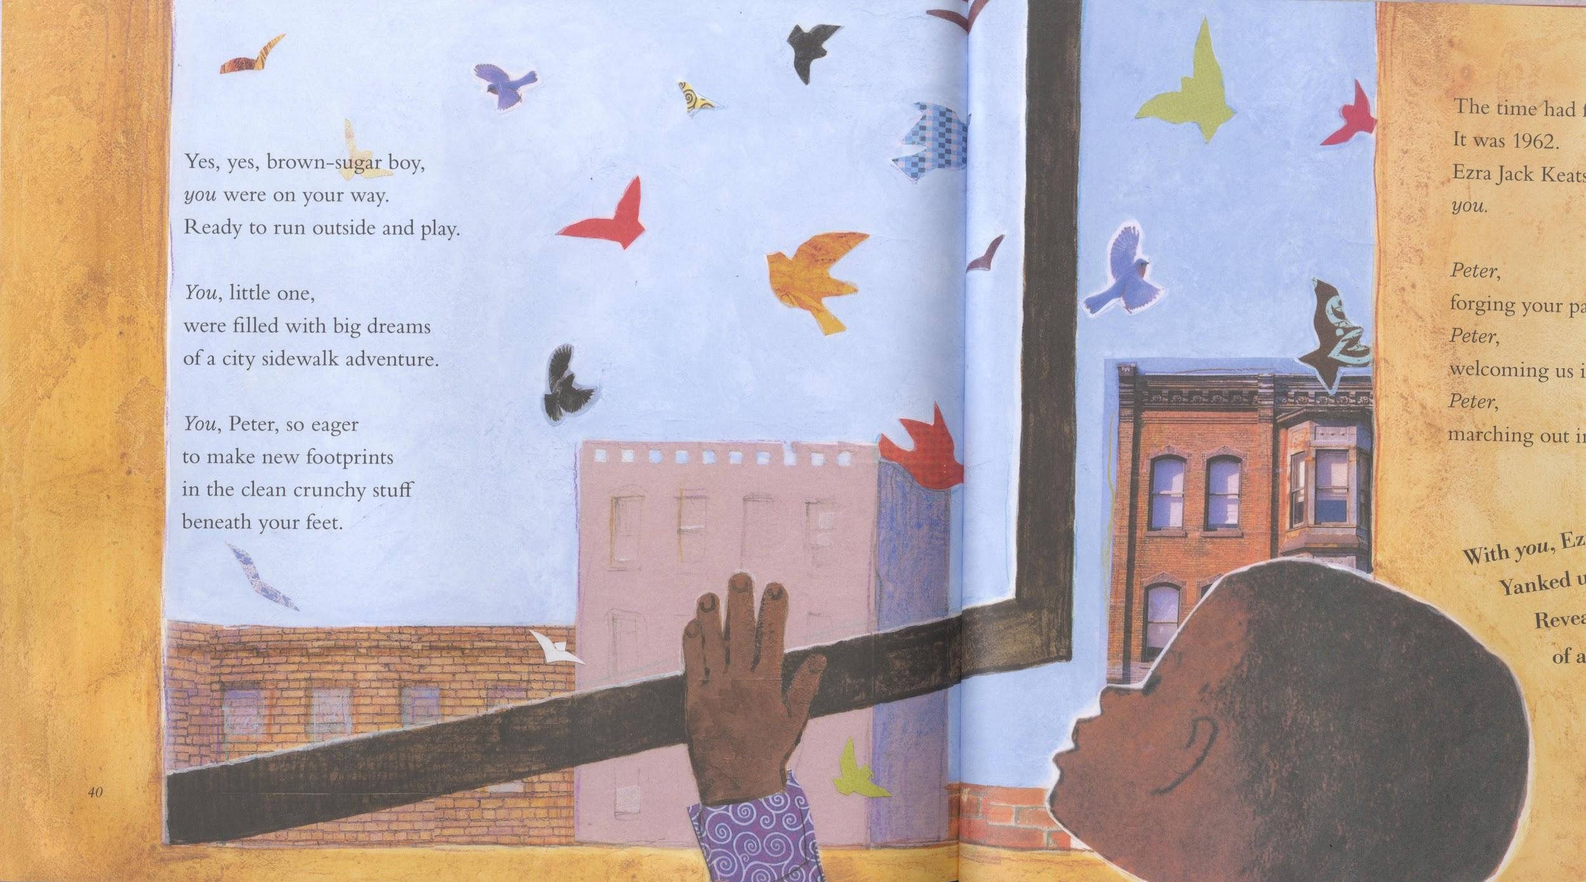
A Tribute to Black Childhood in Music, Story & Pictures
Francelia Butler Lecture
Michelle H. Martin,
Beverly Cleary Professor for Children & Youth Services
& MLIS Chair
Pinkney, Andrea Davis. A Poem for Peter. Illus. Lou Fancher and Steve Johnson. New York: Viking, 2016.

Slide 2
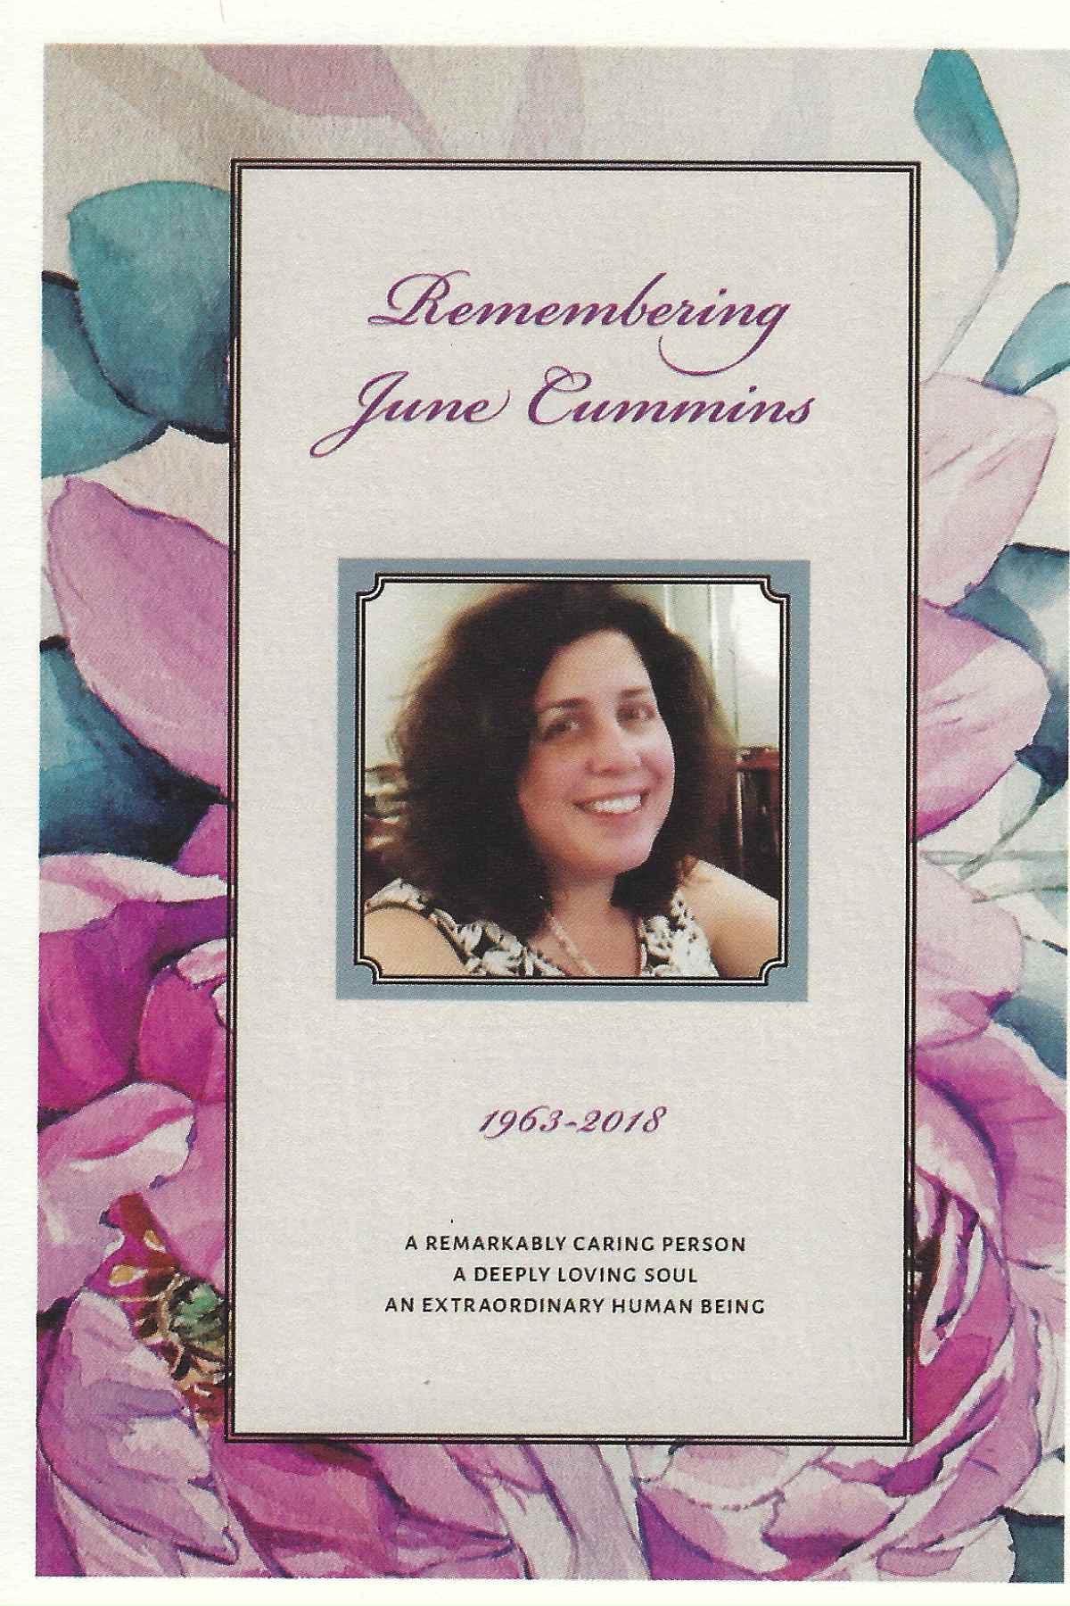
Dedicated to June Cummins
Friend & Colleague for 24 years & Conference Wife

Slide 3
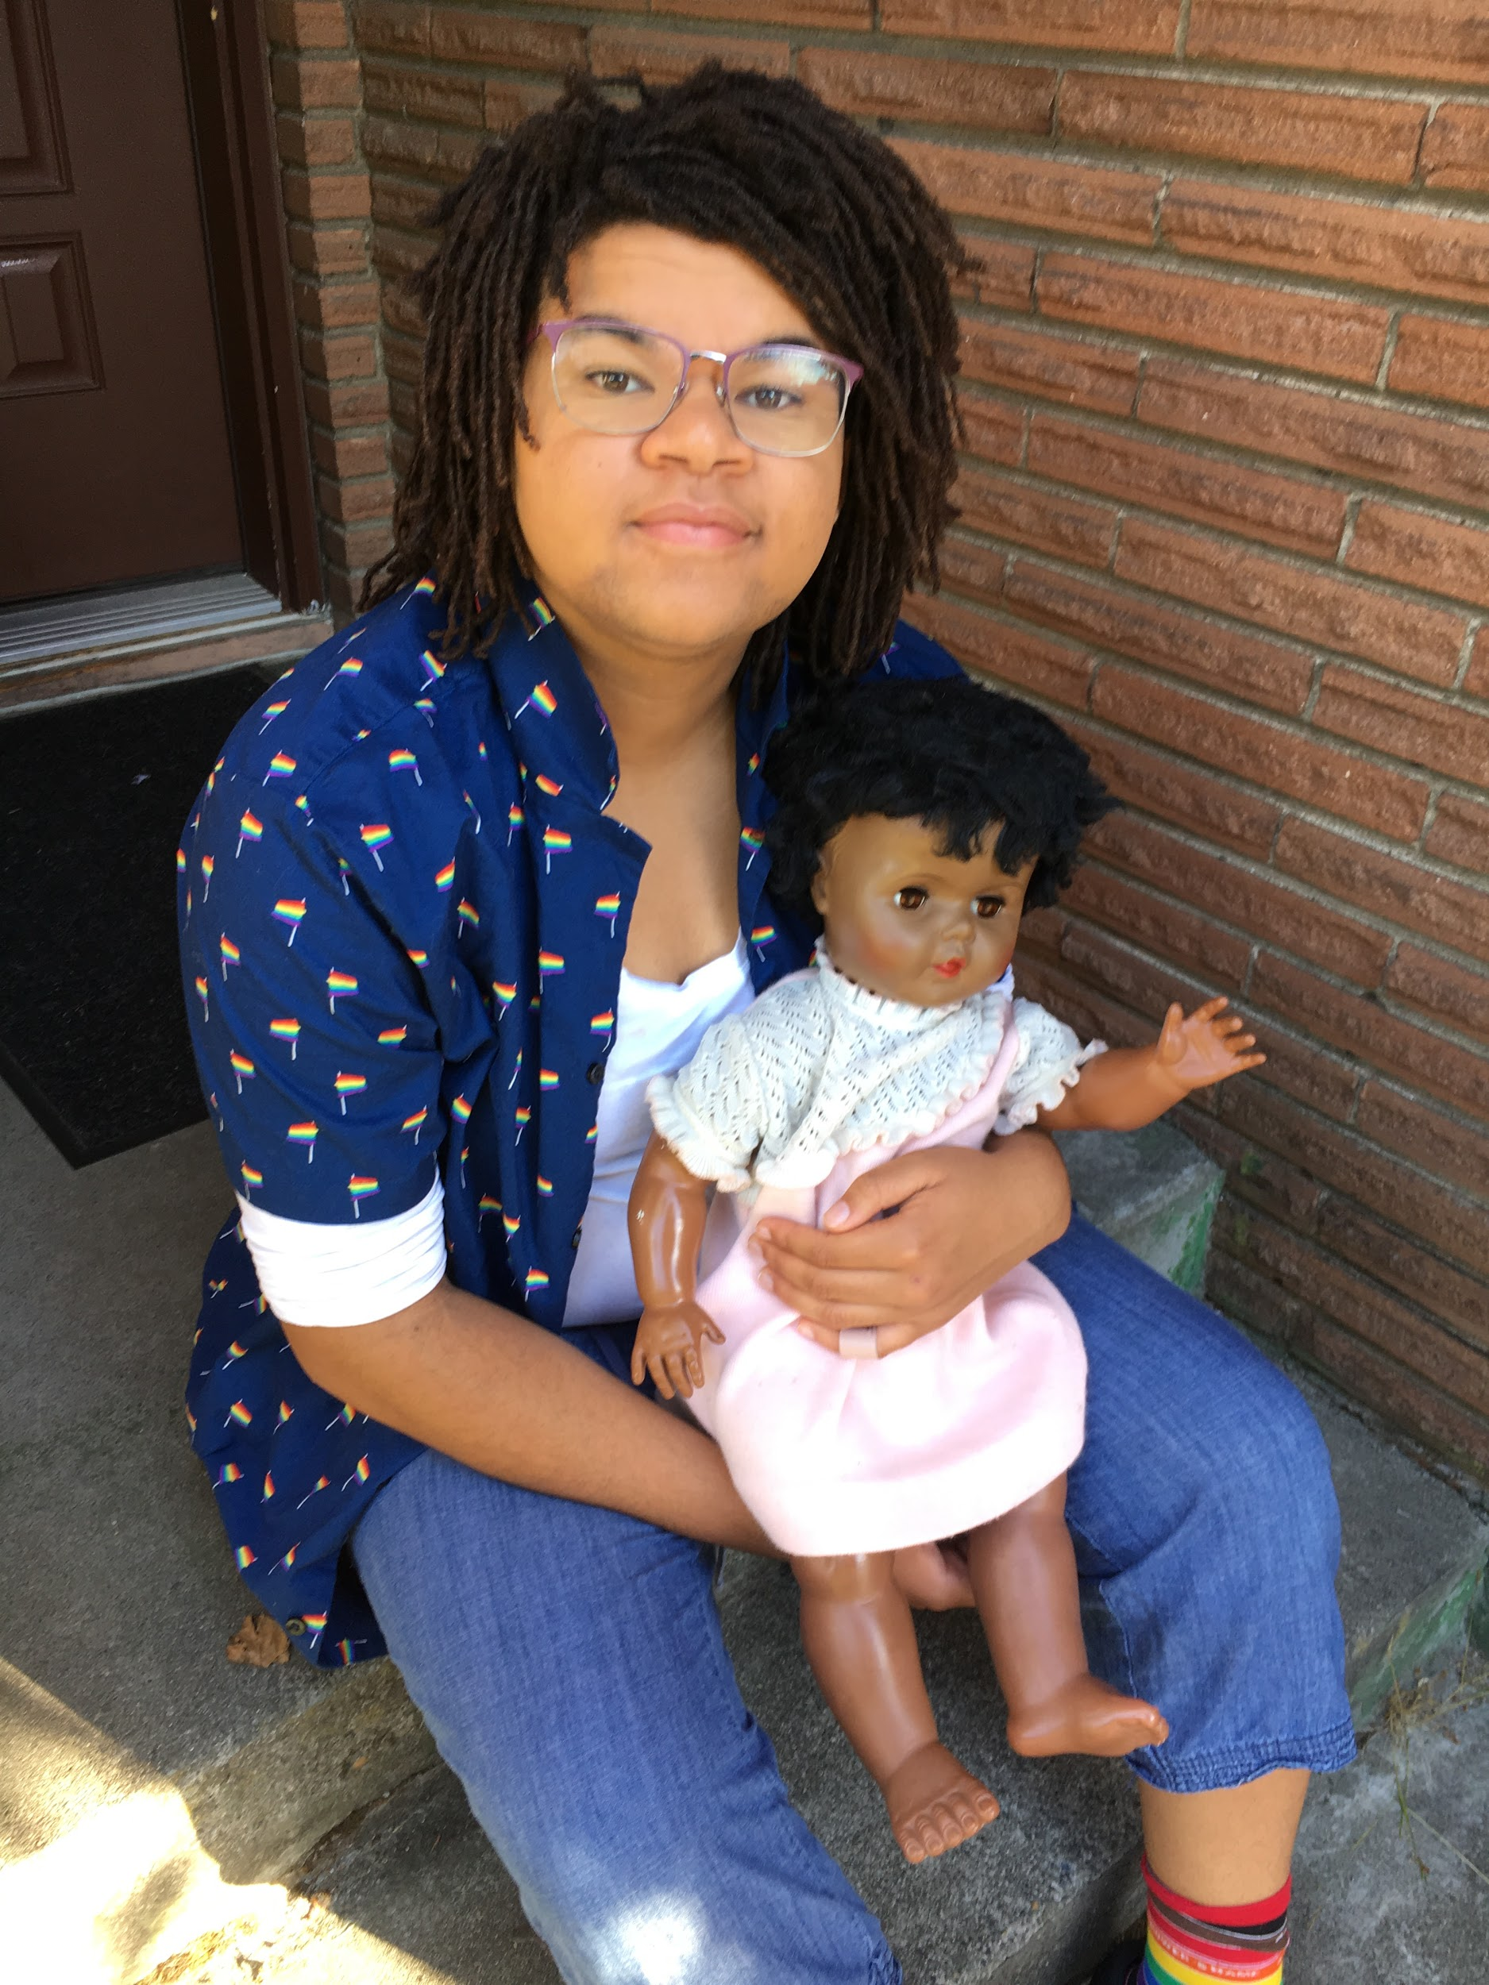
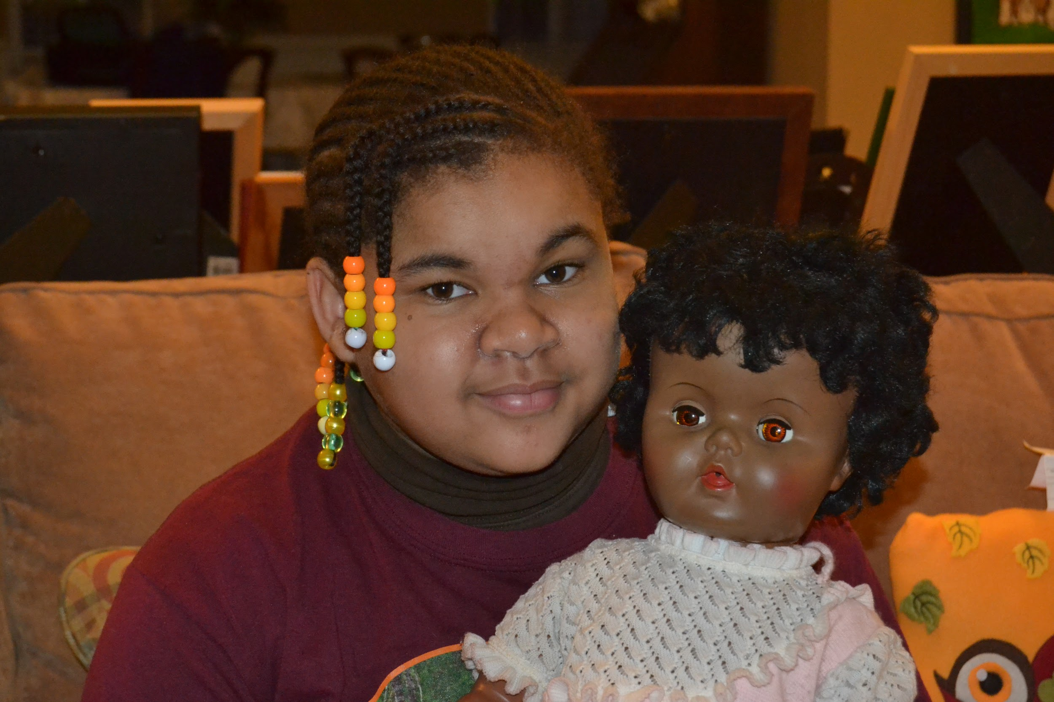
Amelia & The Brown Baby @ Age 10 & 16

Slide 4

https://readingspark.wordpress.com/2016/09/14/picture-this-reflecting-diversity-in-childrens-book-publishing/

Slide 5
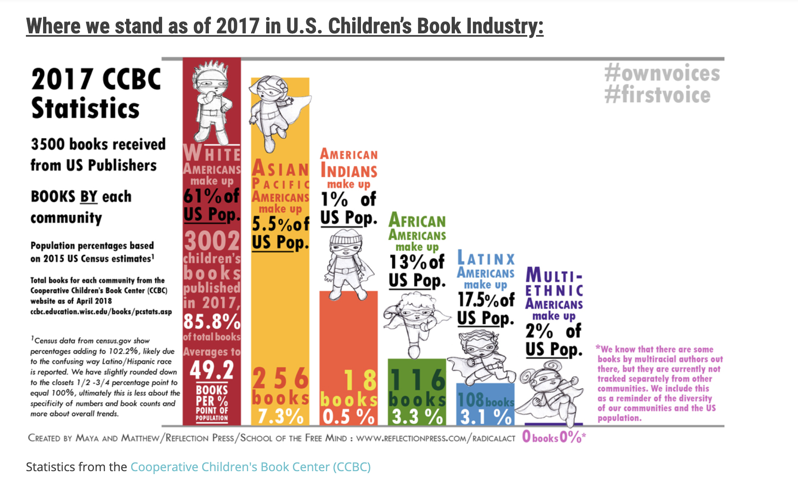
http://www.reflectionpress.com/childrens-books-radicalact/

Slide 6
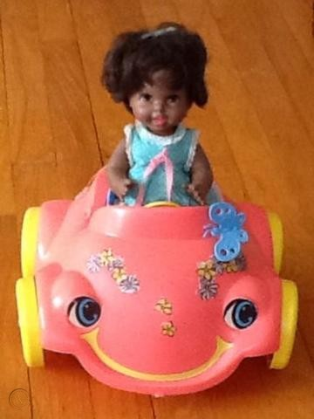
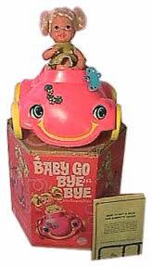
Baby Go Bye-Bye
Baby Go Bye-Bye. Feeling Retro. http://www.feelingretro.com/toys/Girl-Toys/baby-go-bye-bye.php. Accessed 26 Oct. 2019
Vintage 1969 Baby Go Bye Bye Bumpety Buggy Black Doll Car by Mattel. Worthpoint.com. https://www.worthpoint.com/worthopedia/vintage-1969-baby-bye-bye-bumpety-501811302. Accessed 26 Oct. 2019.

Slide 7
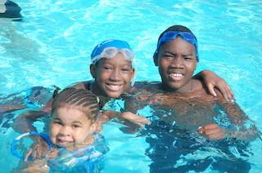
Amelia & Cousins DeAndre & Rheayanna, swimming at Camp Read-a-Rama
Summer 2010

Slide 8
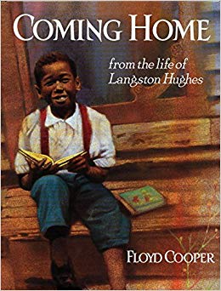
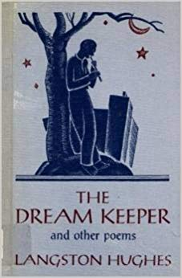
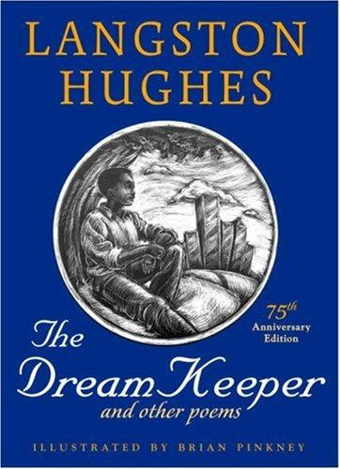
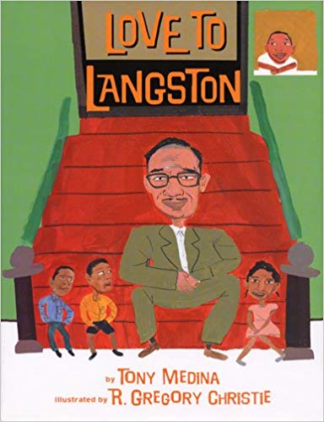
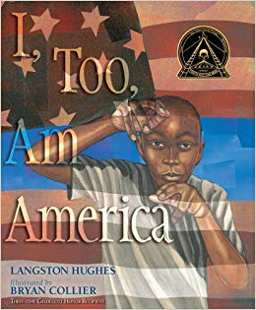
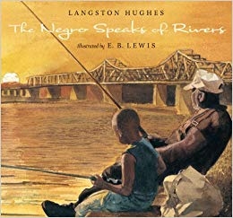
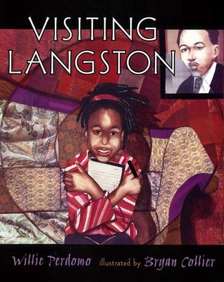
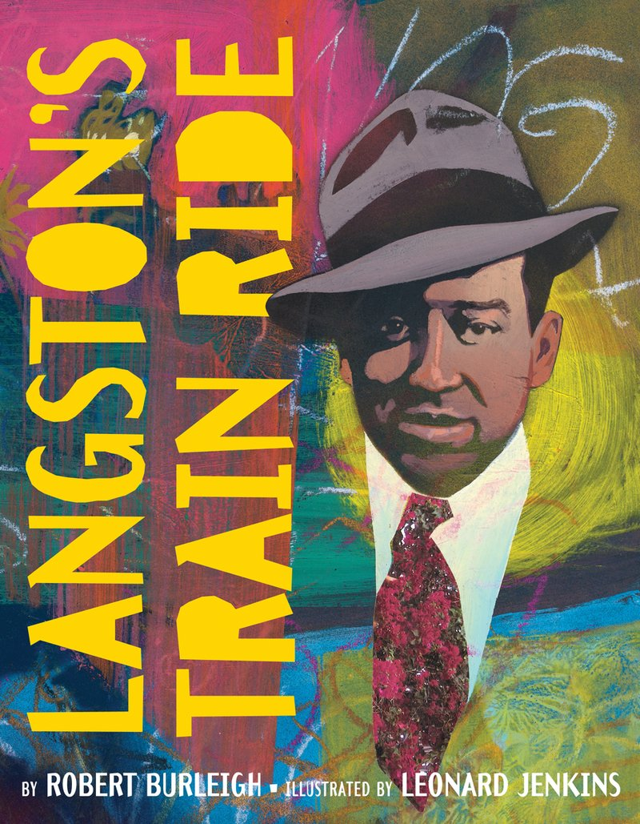
Books Featured in “Langston Hughes”
(1998)
(1932)
(2007)
(2002)
(2004)
(2012)
(2002)
(2002)

Slide 9
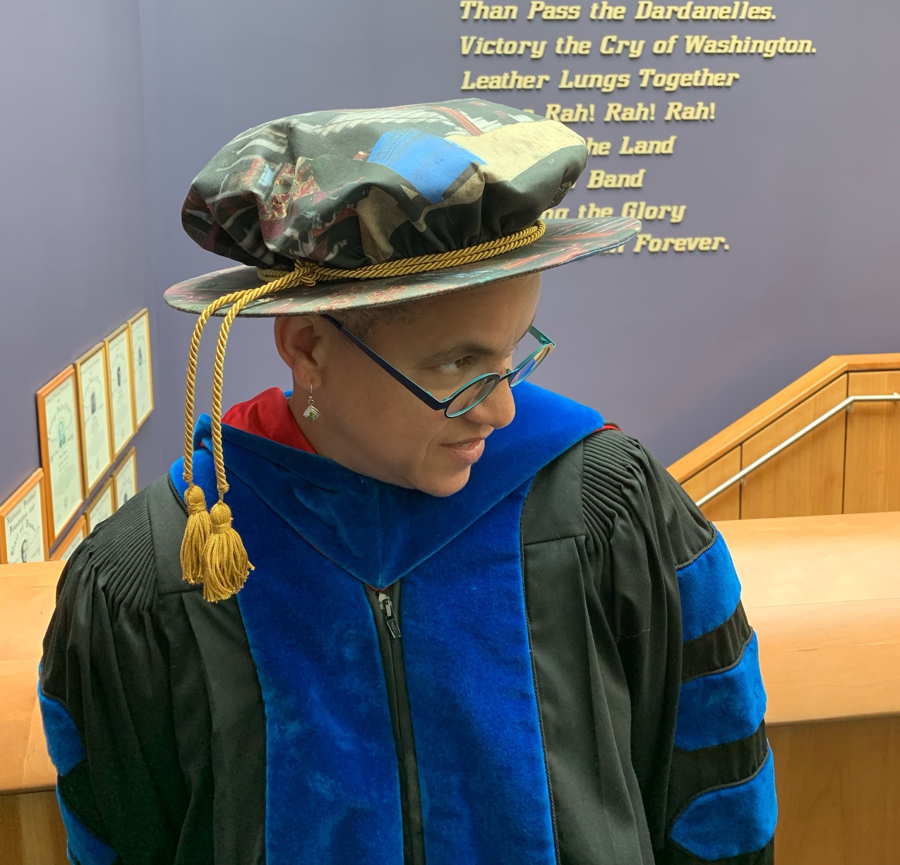
My new Oxford Renaissance Bonnet made from
Bryan Collier’s illustration in Uptown
University of Washington iSchool Convocation, 2019

Slide 10
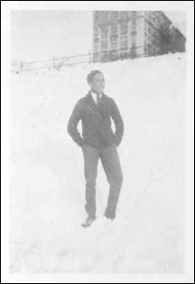
Langston Hughes
Michelle H. Martin © 2019
"Langston Hughes at Central High School (Cleveland)." Beinecke Rare Book and Manuscript Library, Yale Collection of American Literature, New Haven. Photo Negative, ca. 1916-20.

Slide 11
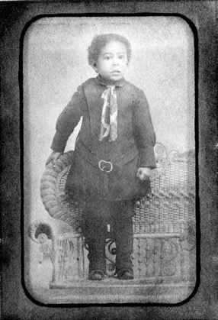
Langston, Langston, Langston Hughes,
Wrote poems for the people and he loved the blues.
Langston, Langston, Langston Hughes,
Wrote poems for the people and he lived the blues.
"Langston Hughes at Age 3." Beinecke Rare Book and Manuscript Library, Yale Collection of American Literature, New Haven. Photo Negative.

Slide 12
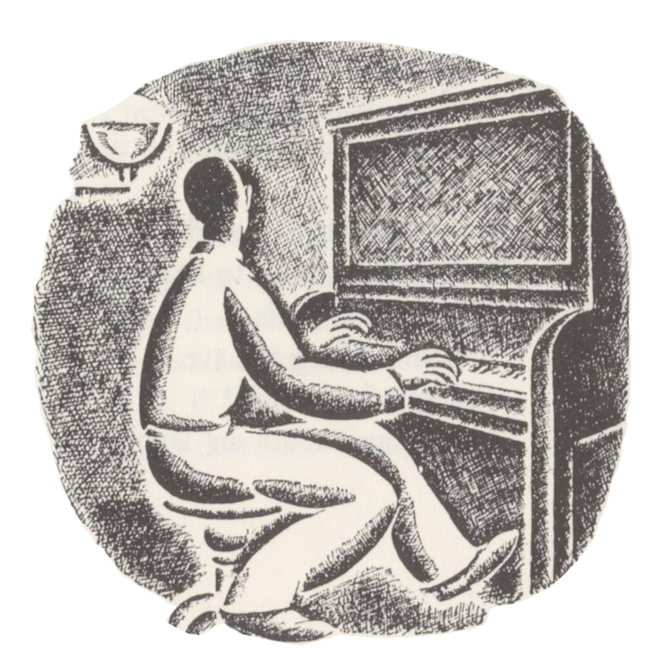
Langston Hughes was the Keeper of Dreams,
He wrote jazz poems no one had ever seen.
Hughes, Langston. The Dream Keeper and Other Poems. Illus. Helen Sewell.
Alfred A. Knopf, 1986.

Slide 13
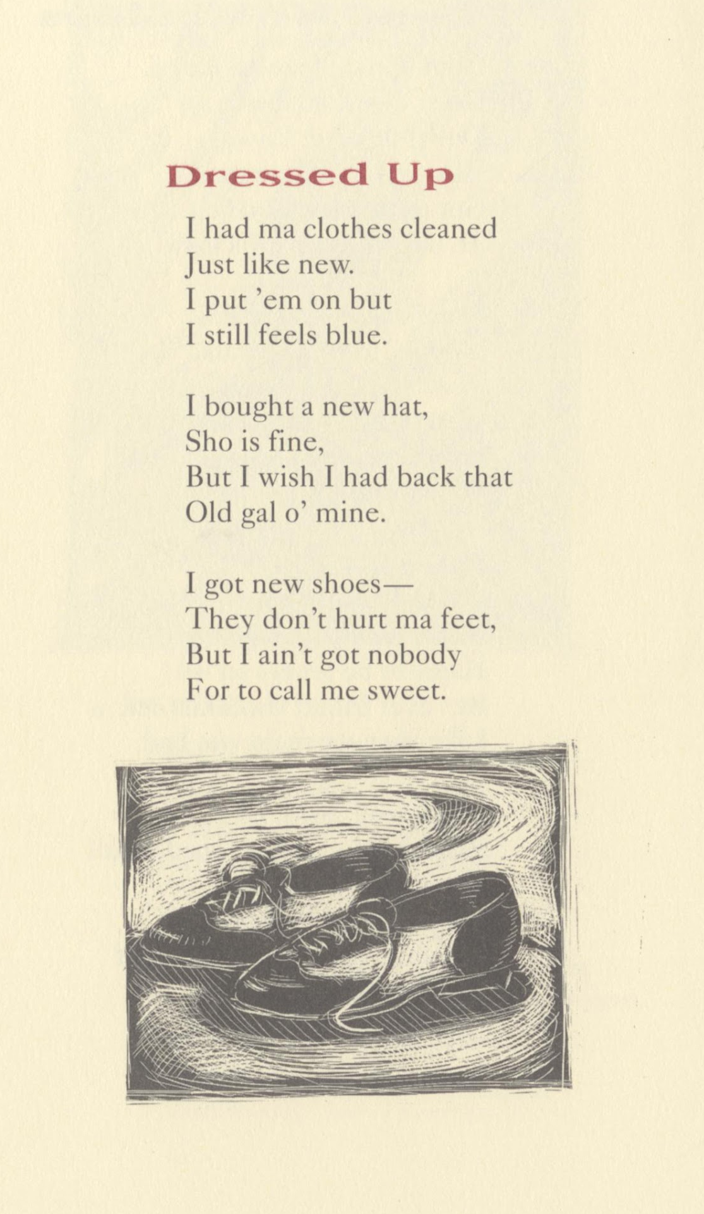
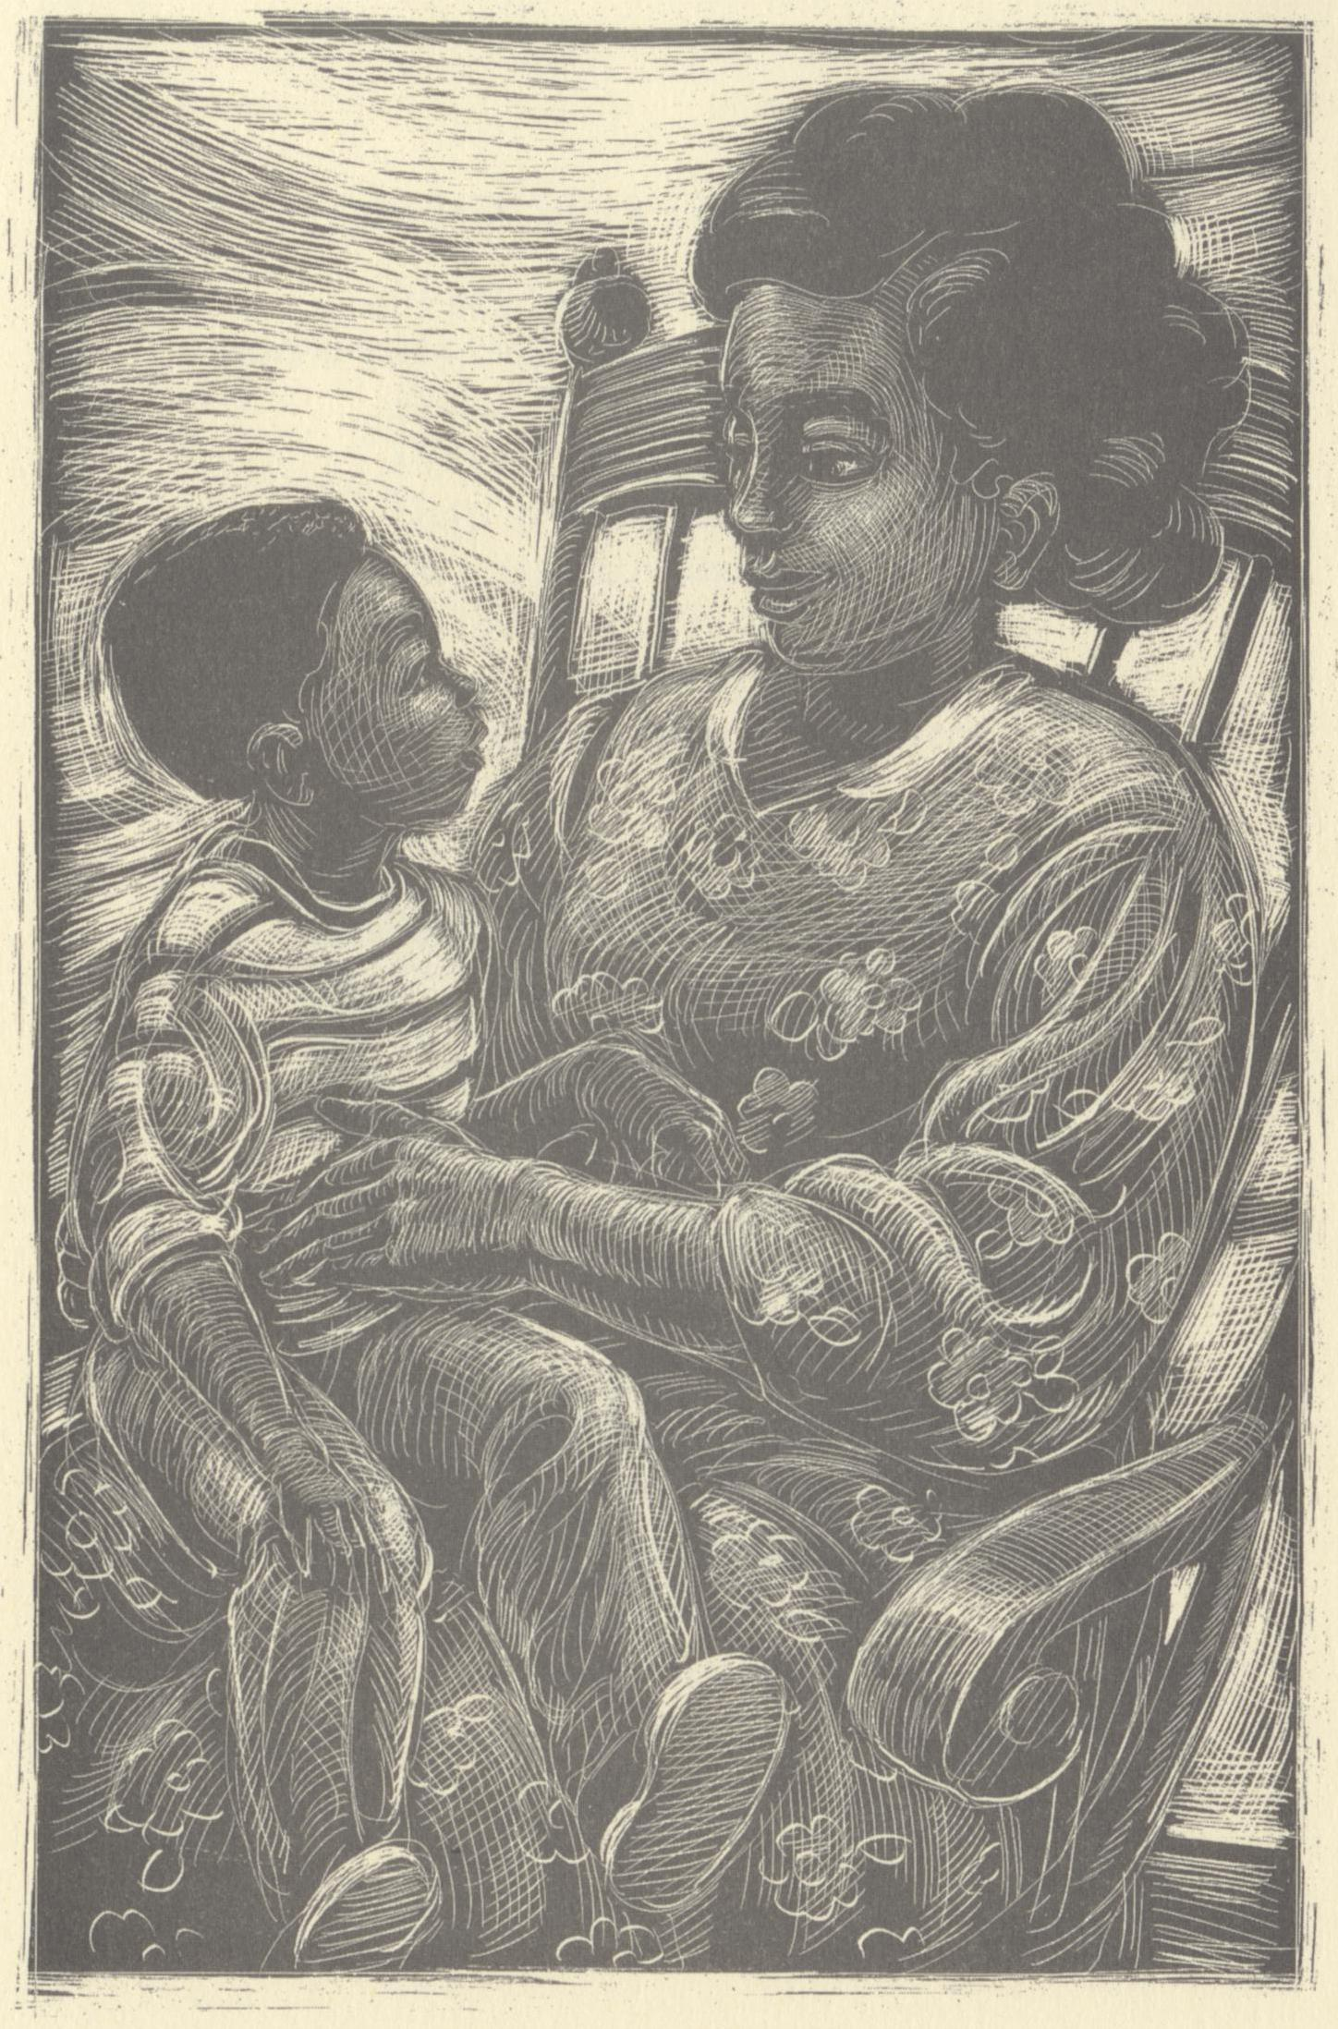
From Aunt Sue’s Stories to the Weary Blues,
Mother to Son and those dressed-up shoes.
Hughes, Langston. The Dream Keeper and Other Poems. Illus. Brian Pinkney.
Alfred A. Knopf, 1994.

Slide 14
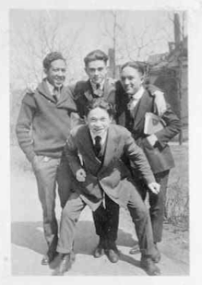
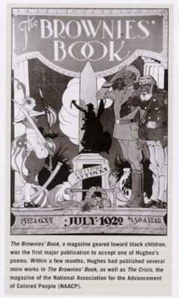
Hughes wrote poems while he was still a teen,
For the school newspaper and the Brownies’ Magazine.
"Langston Hughes at Central High School (Cleveland)." Beinecke Rare Book and Manuscript Library, Yale Collection of American Literature, New Haven. Photo Negative, ca. 1916-20. &
Brownies’ Book Magazine, July 1920/ From Langston Hughes: Poet by Jack Rummel.
Philadelphia: Chelsea House, 2005

Slide 15
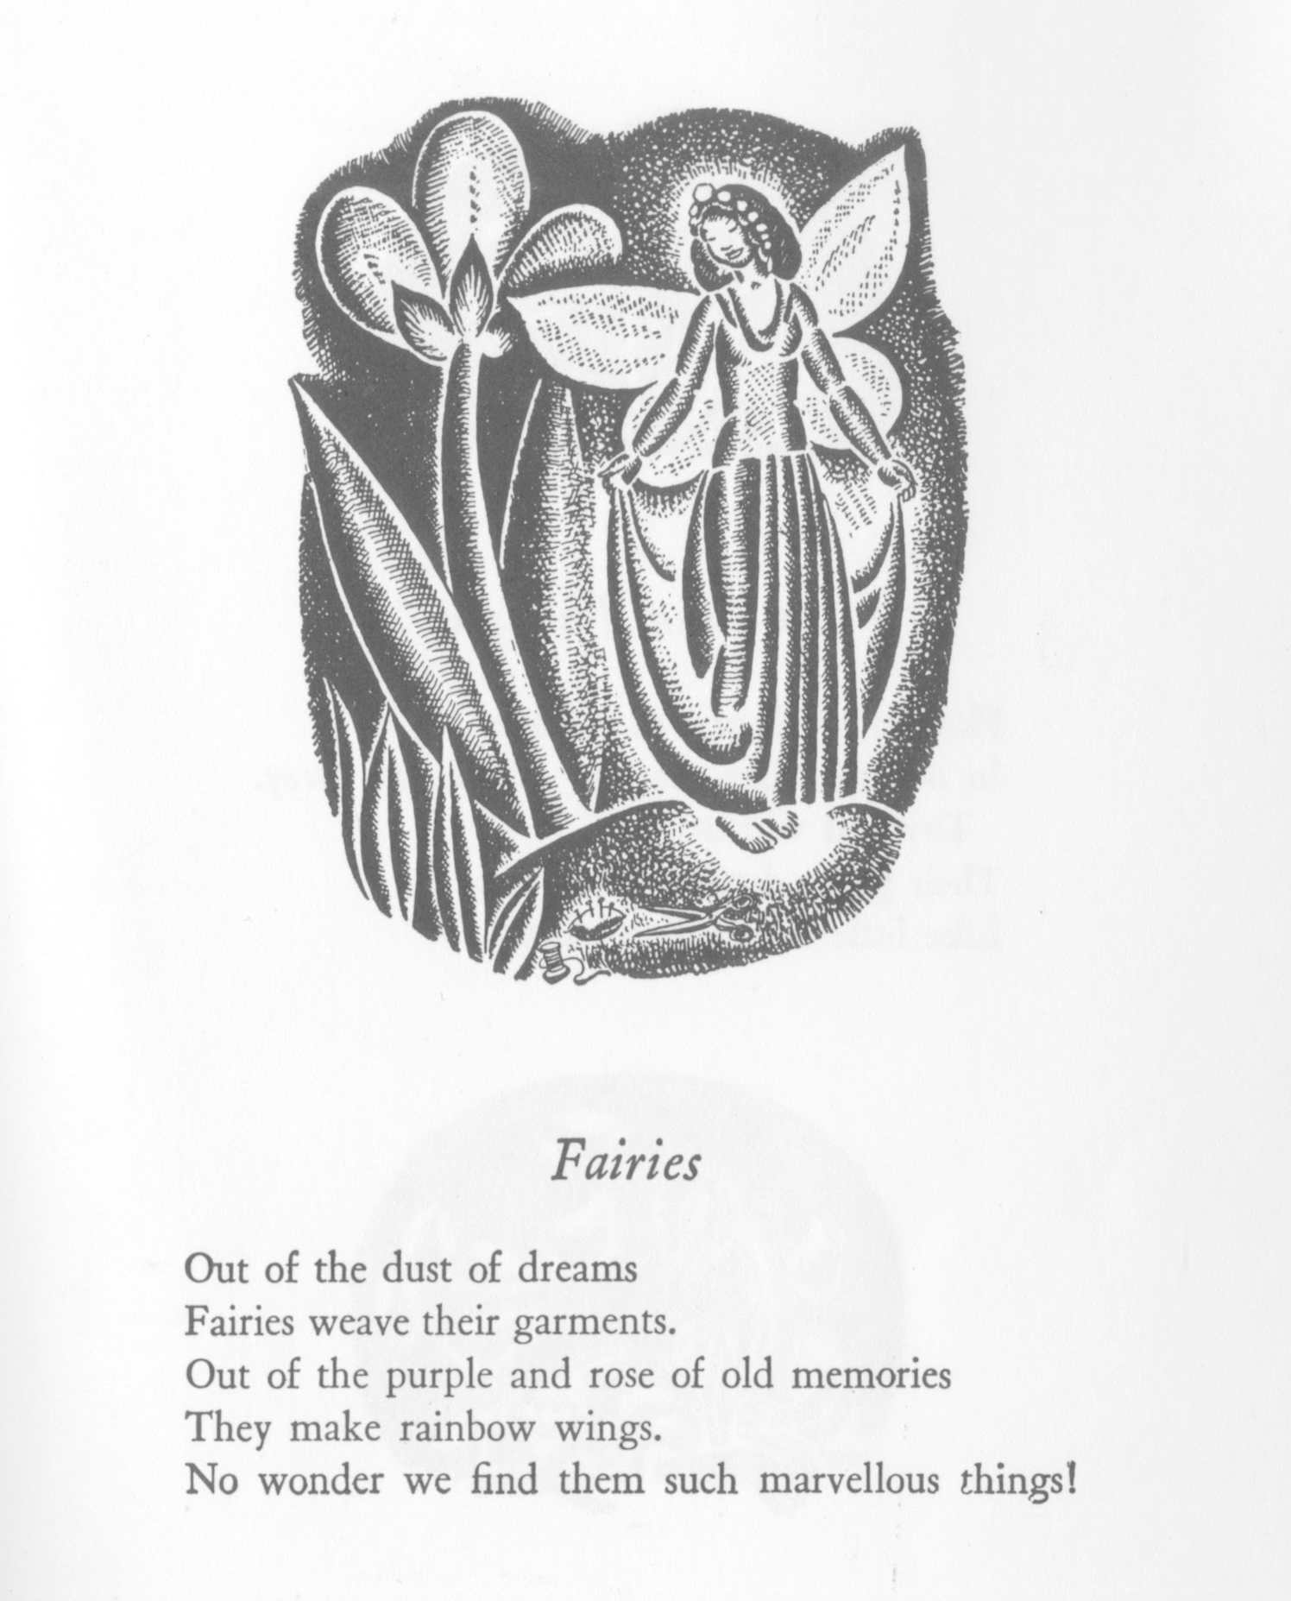
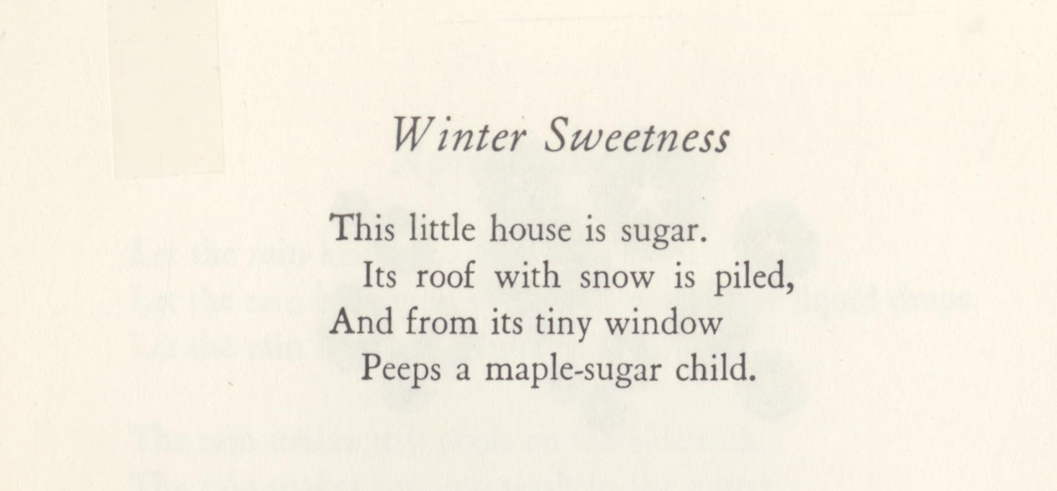
He brought to life a Maple Sugar Child,
And he wove a tale of fairies with a rainbow style!
Hughes, Langston. The Dream Keeper and Other Poems. Illus. Helen Sewell.
Alfred A. Knopf, 1986.

Slide 16
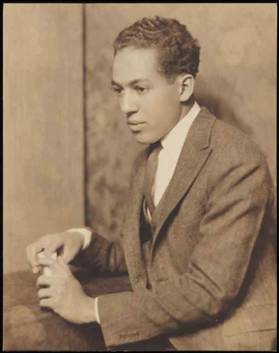
Langston, Langston, Langston Hughes,
Wrote poems for the people and he loved the blues.
Langston, Langston, Langston Hughes,
Wrote poems for the people and he lived the blues.
"Langston Hughes." Beinecke Rare Book and Manuscript Library, Yale Collection of American Literature, New Haven. Still Image.

Slide 17
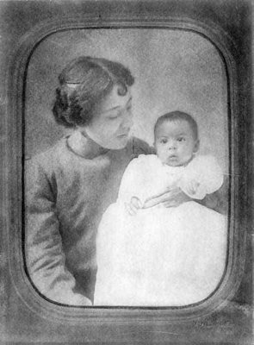
Langston’s mother was a rollin’ stone.
Raised by his Grandma, who gave him a home.
"Langston Hughes as a baby, with mother, Carolyn Clark." Beinecke Rare Book and Manuscript Library, Yale Collection of American Literature, New Haven. Still Image.

Slide 18
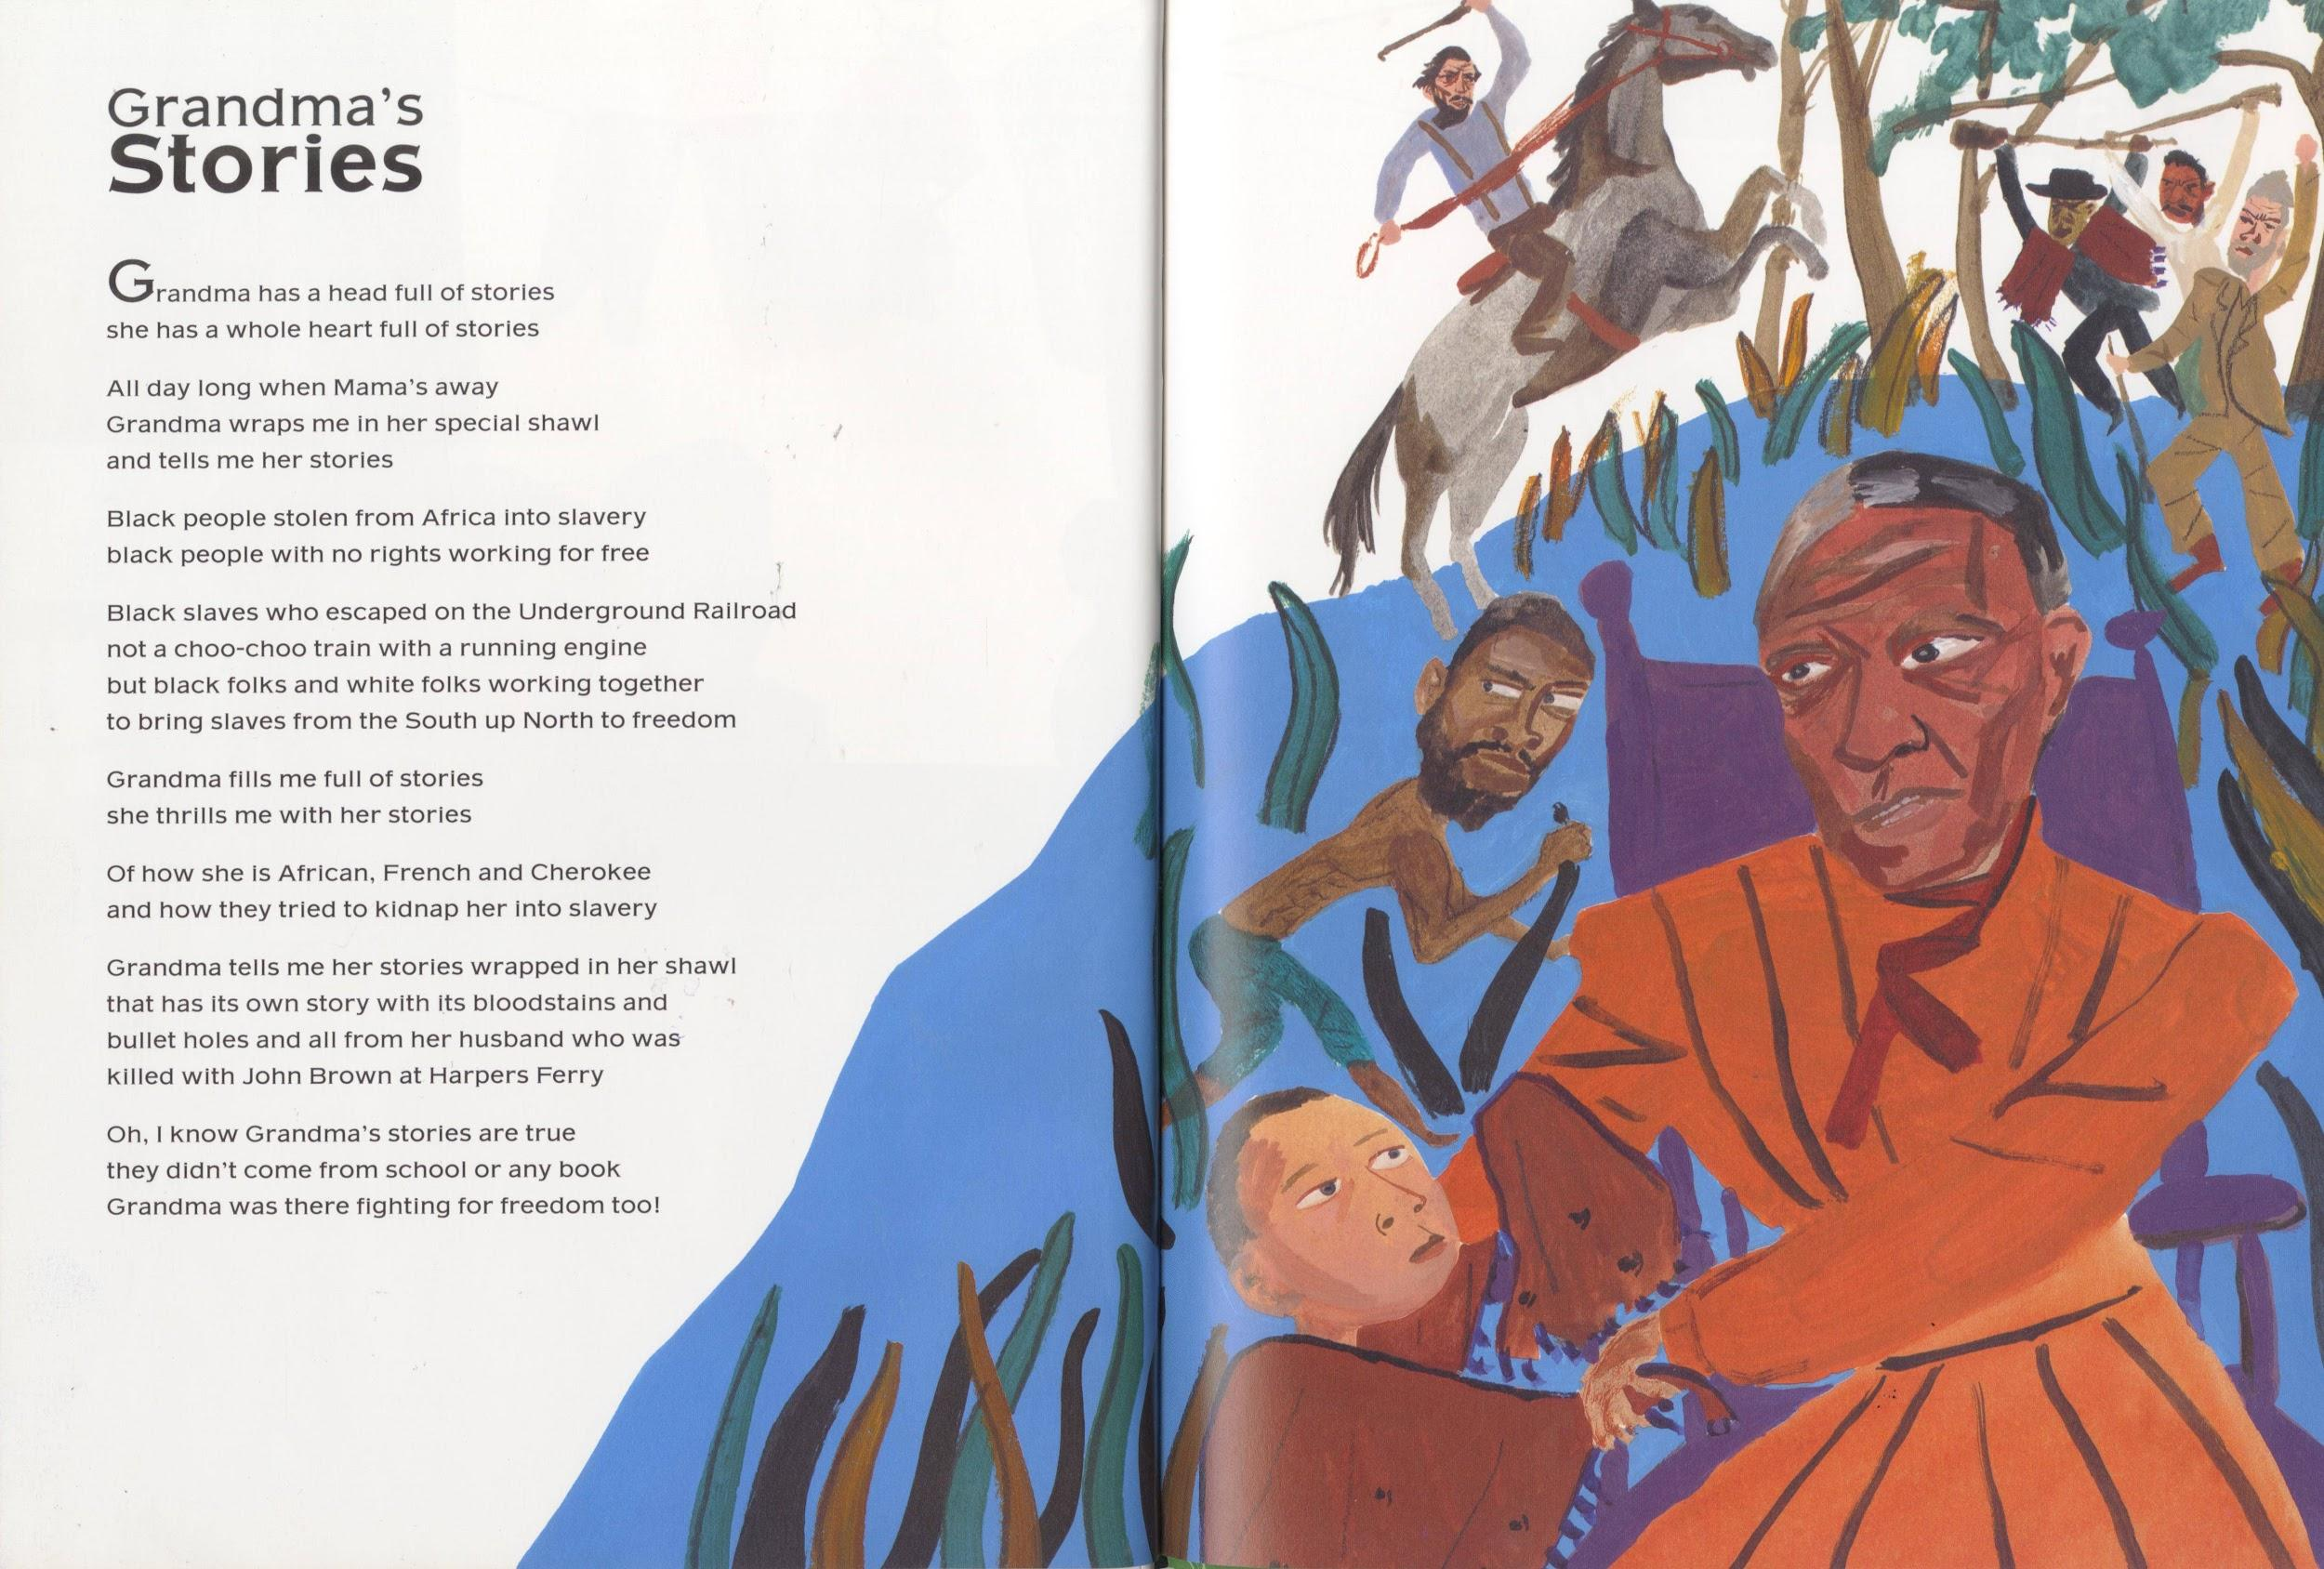
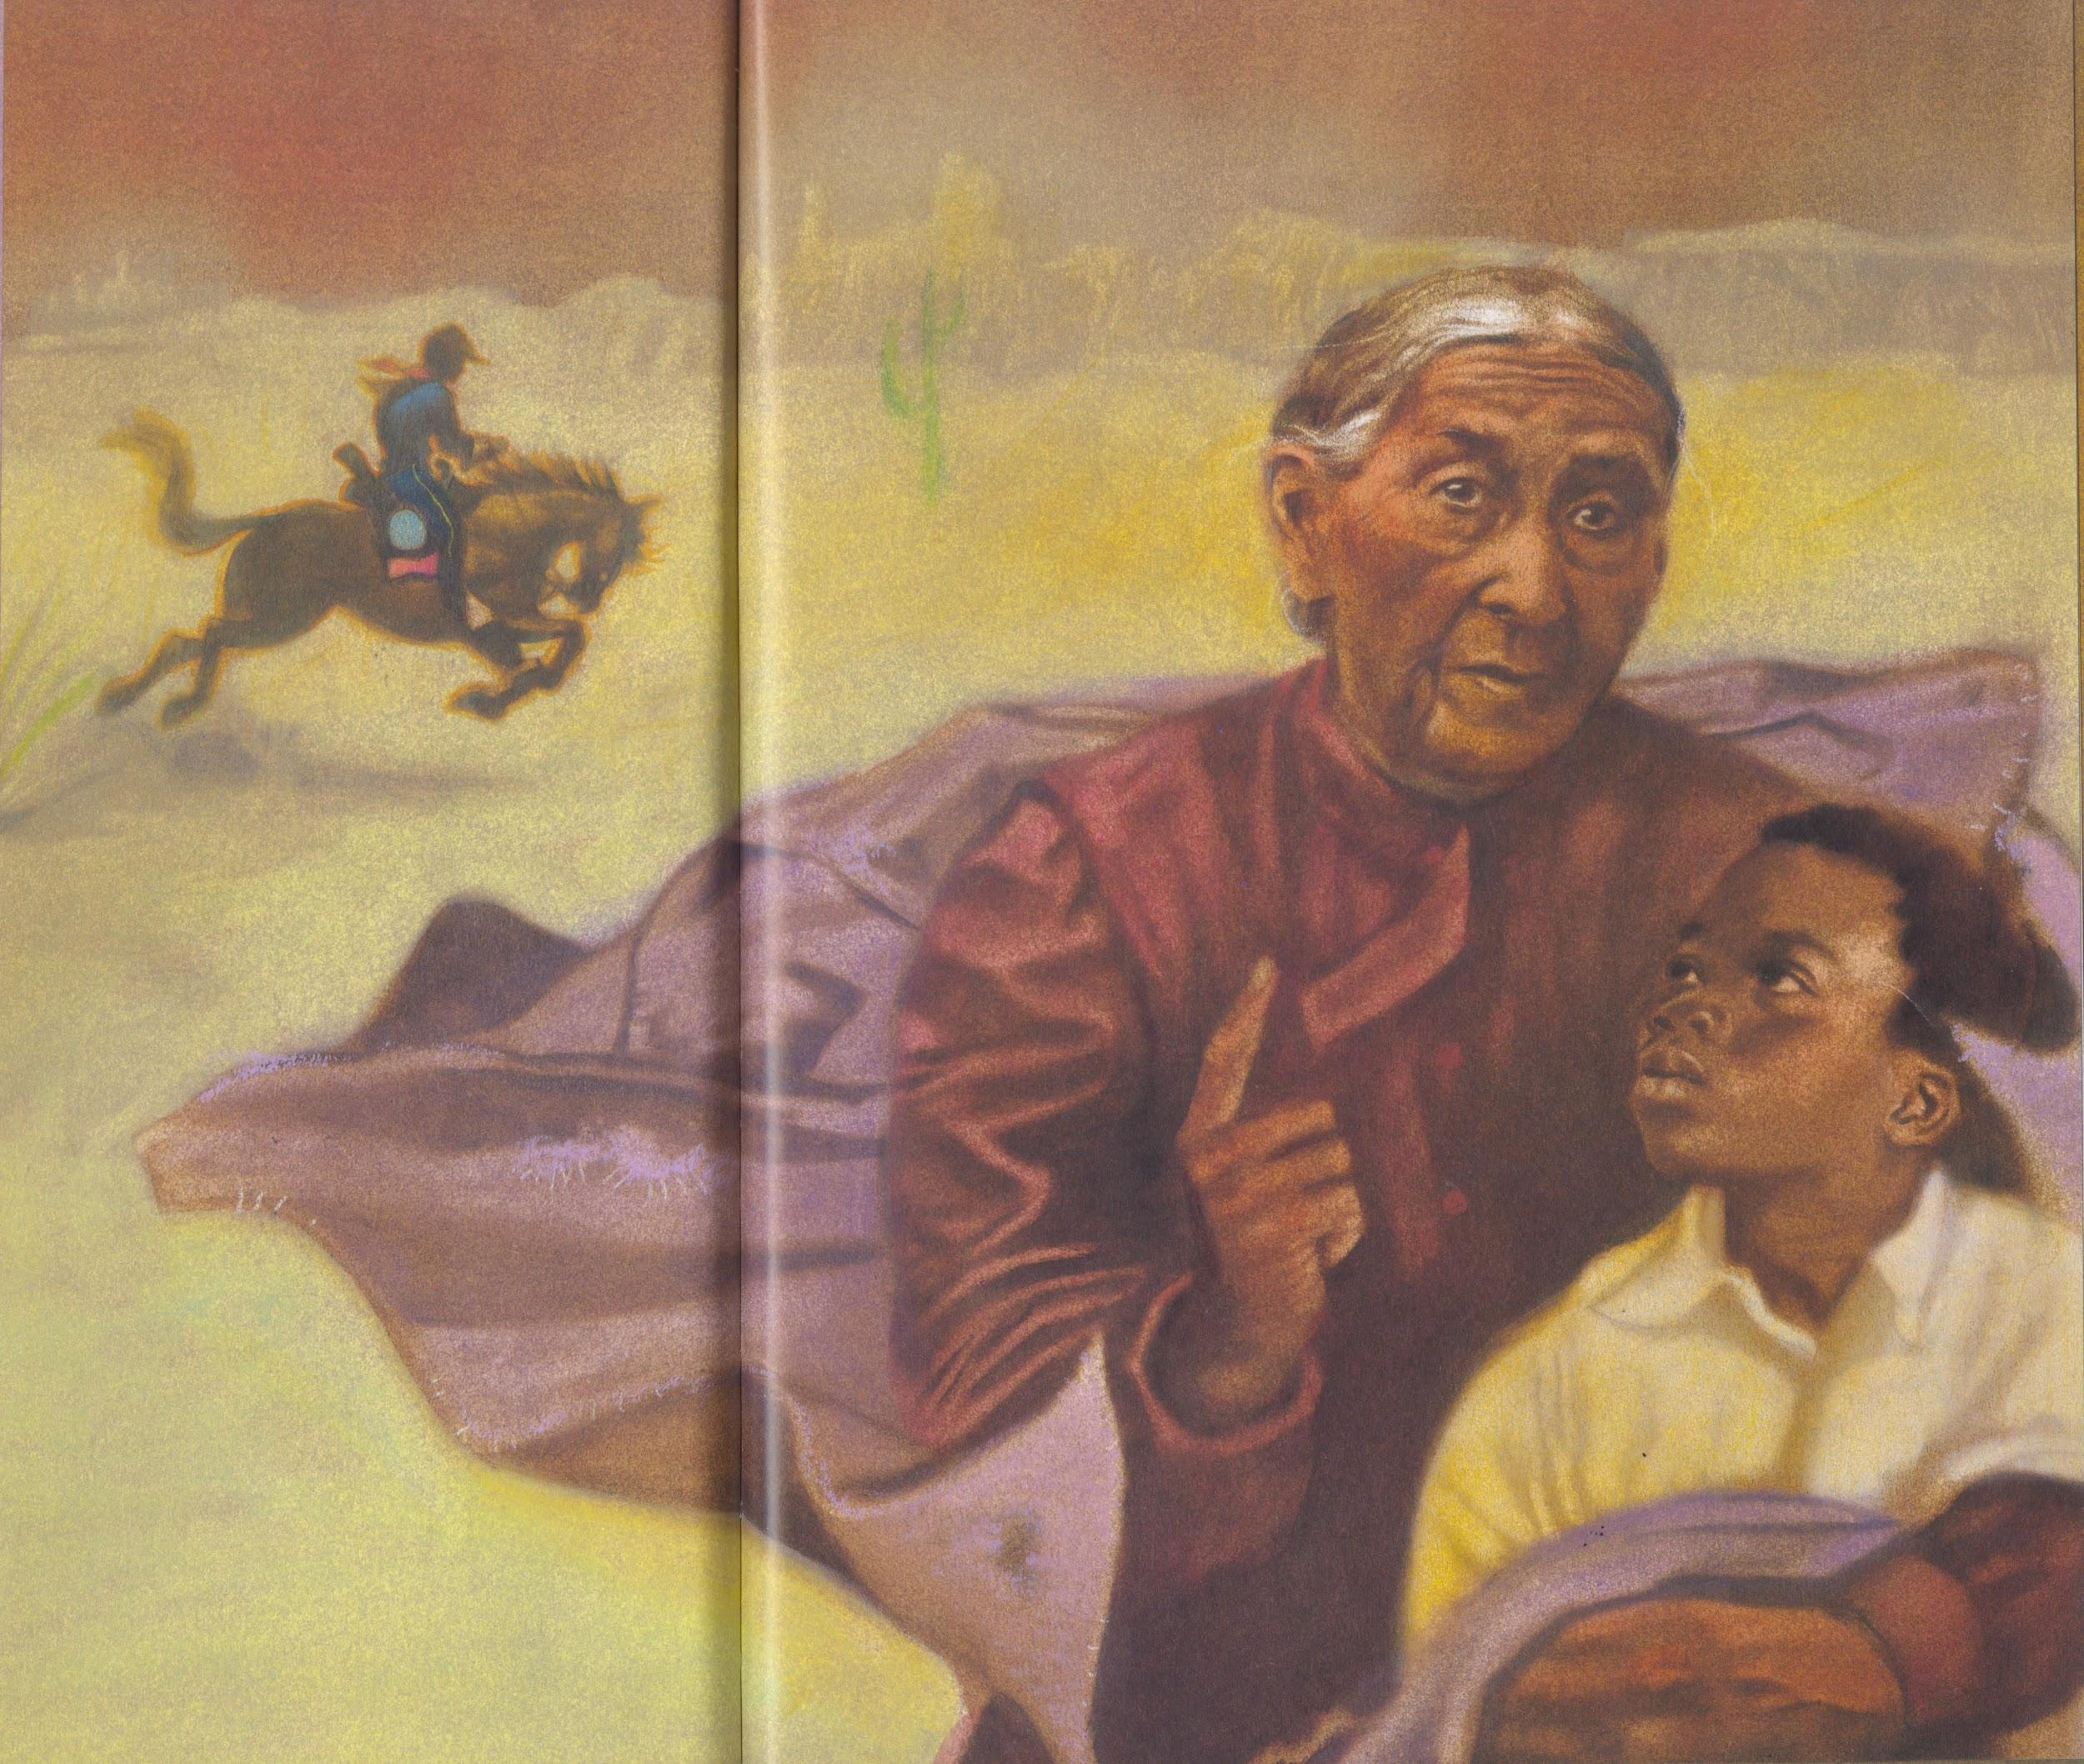
Told true stories of John Brown’s raid,
Of Lewis Sheridan Leary and the price he paid.
Medina, Tony. Love to Langston. Illus. R. Gregory. Lee & Low Books Inc., 2002.
Cooper, Floyd. Coming Home: from the Life of Langston Hughes. Philomel, 1994.

Slide 19
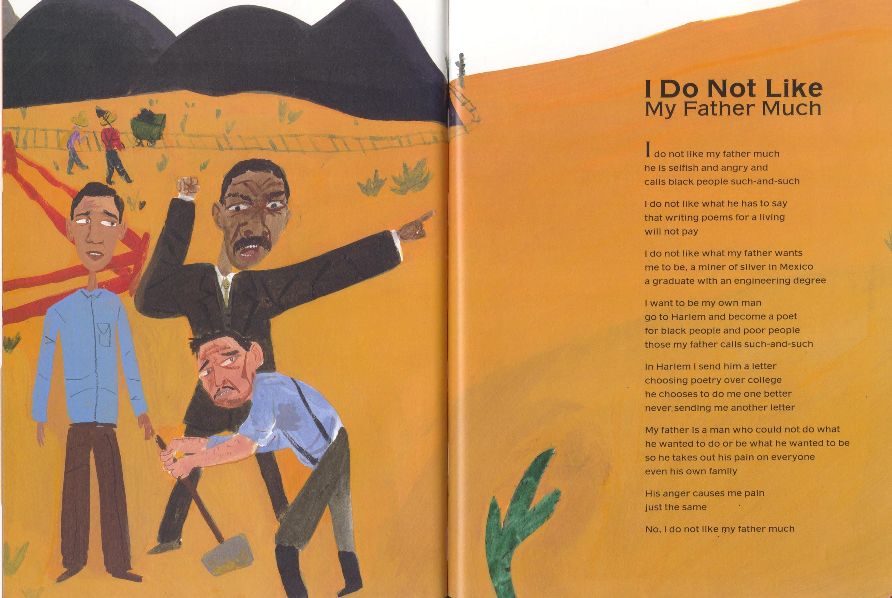
Langston did not like his father much,
Who said of Black people they were such and such,
Medina, Tony. Love to Langston. Illus. R. Gregory. Lee & Low Books Inc., 2002.

Slide 20
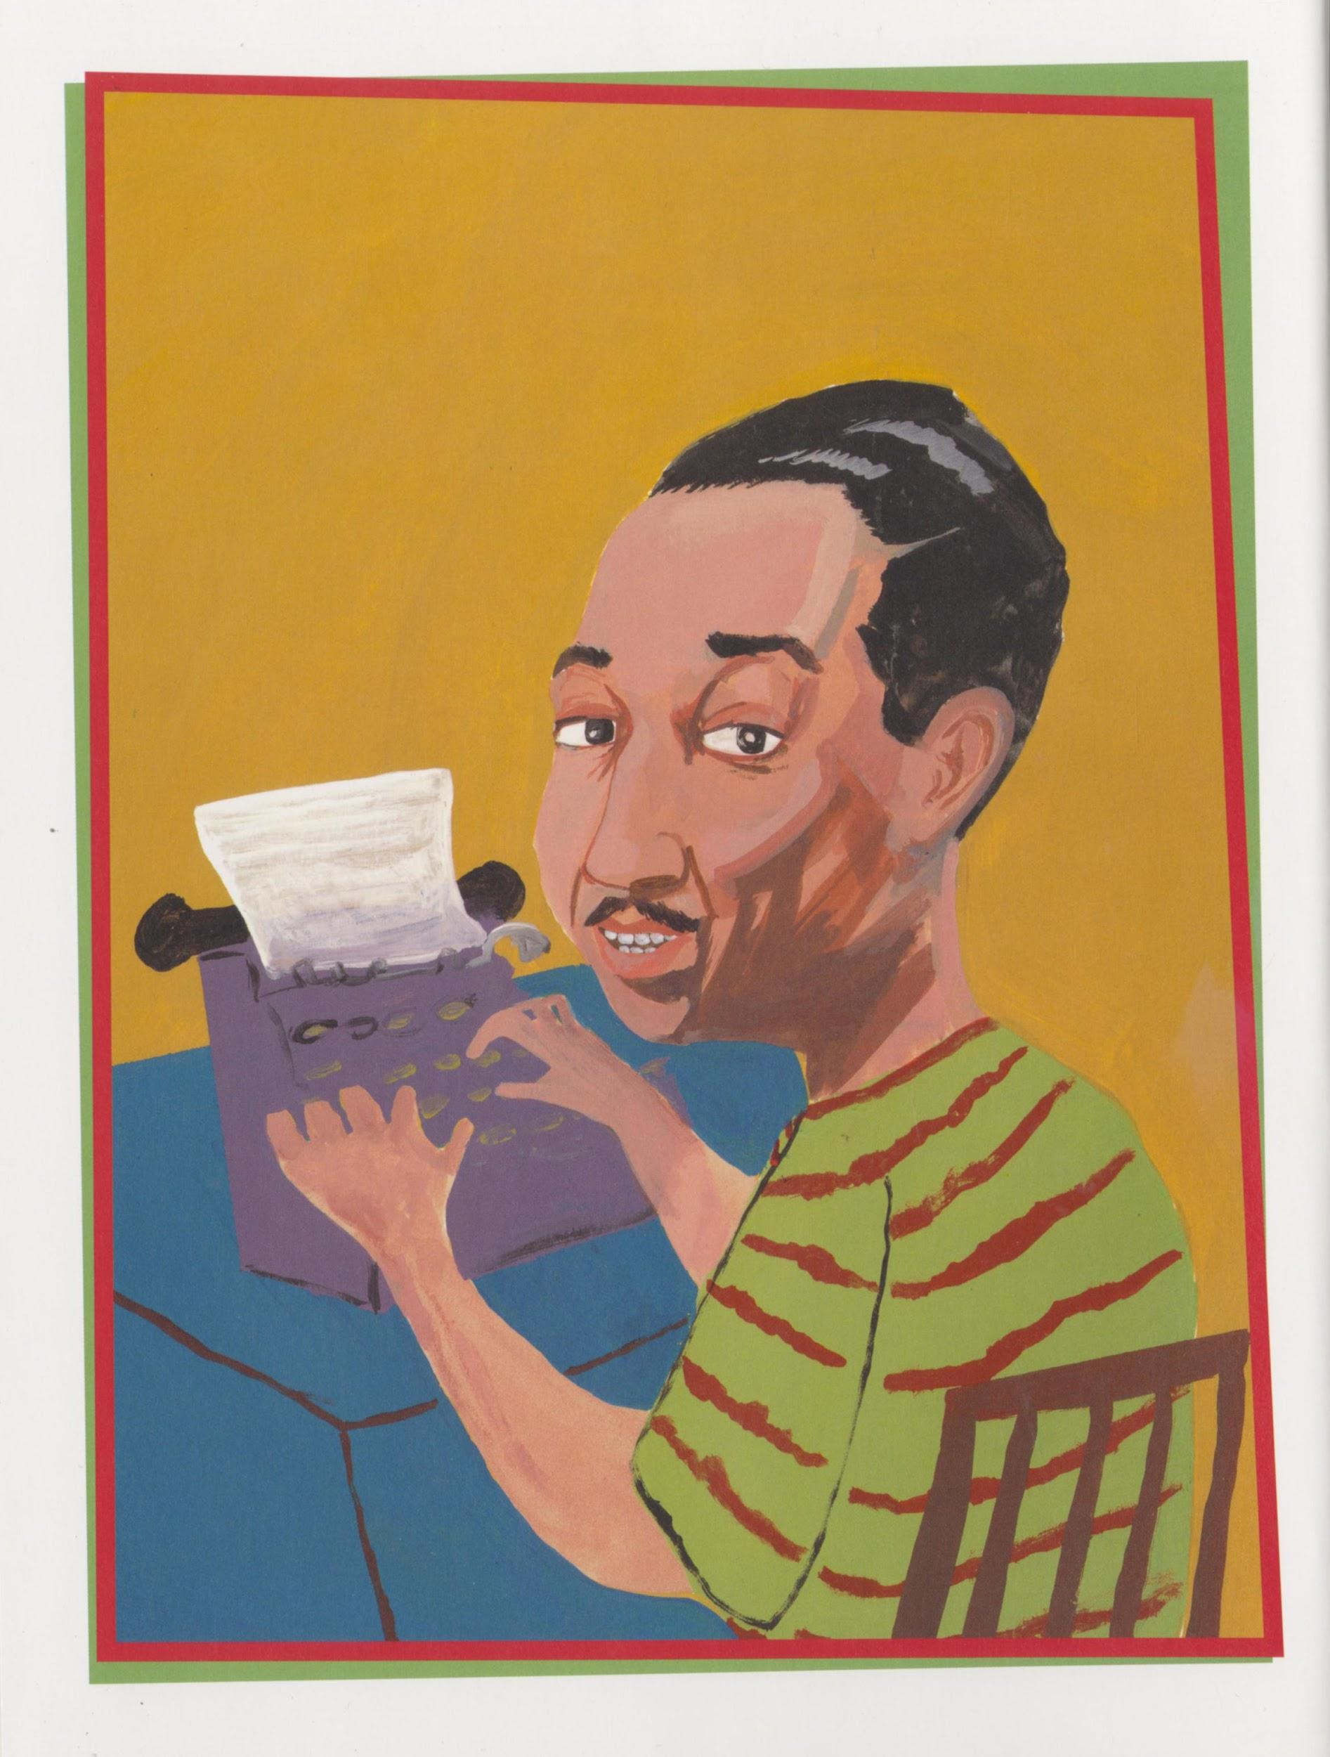
Langston ignored what he had to say,
That writing for living would just never pay!
Medina, Tony. Love to Langston. Illus. R. Gregory. Lee & Low Books Inc., 2002.

Slide 21
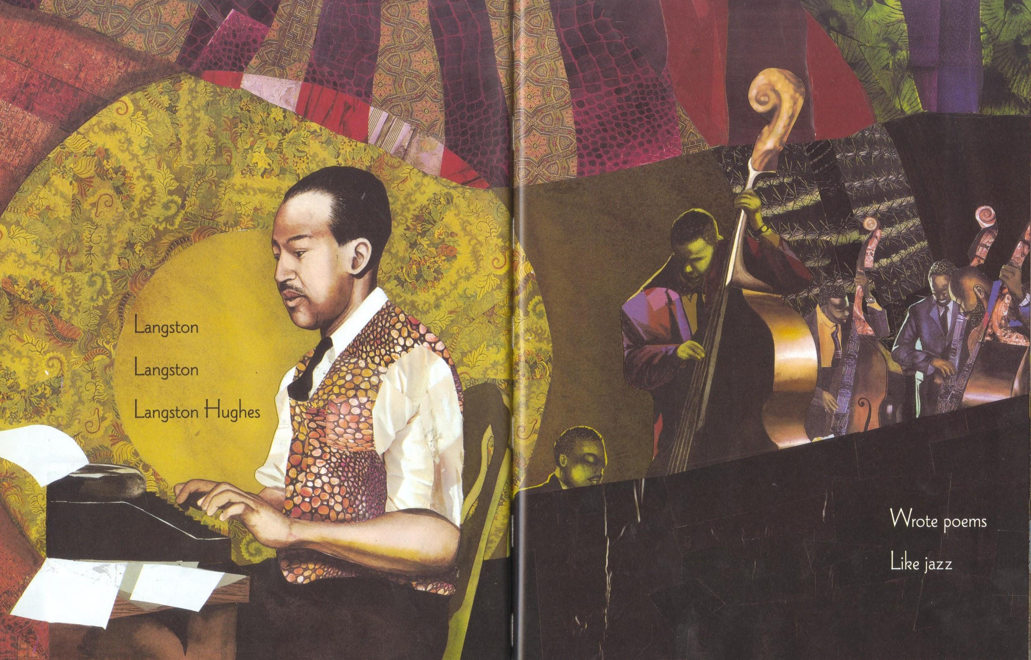
Langston, Langston, Langston Hughes,
Wrote poems for the people and he loved the blues.
Langston, Langston, Langston Hughes,
Wrote poems for the people and he lived the blues.
Perdomo, Willie. Visiting Langston. Illus. Bryan Collier. Henry Holt and Company, 2002.

Slide 22
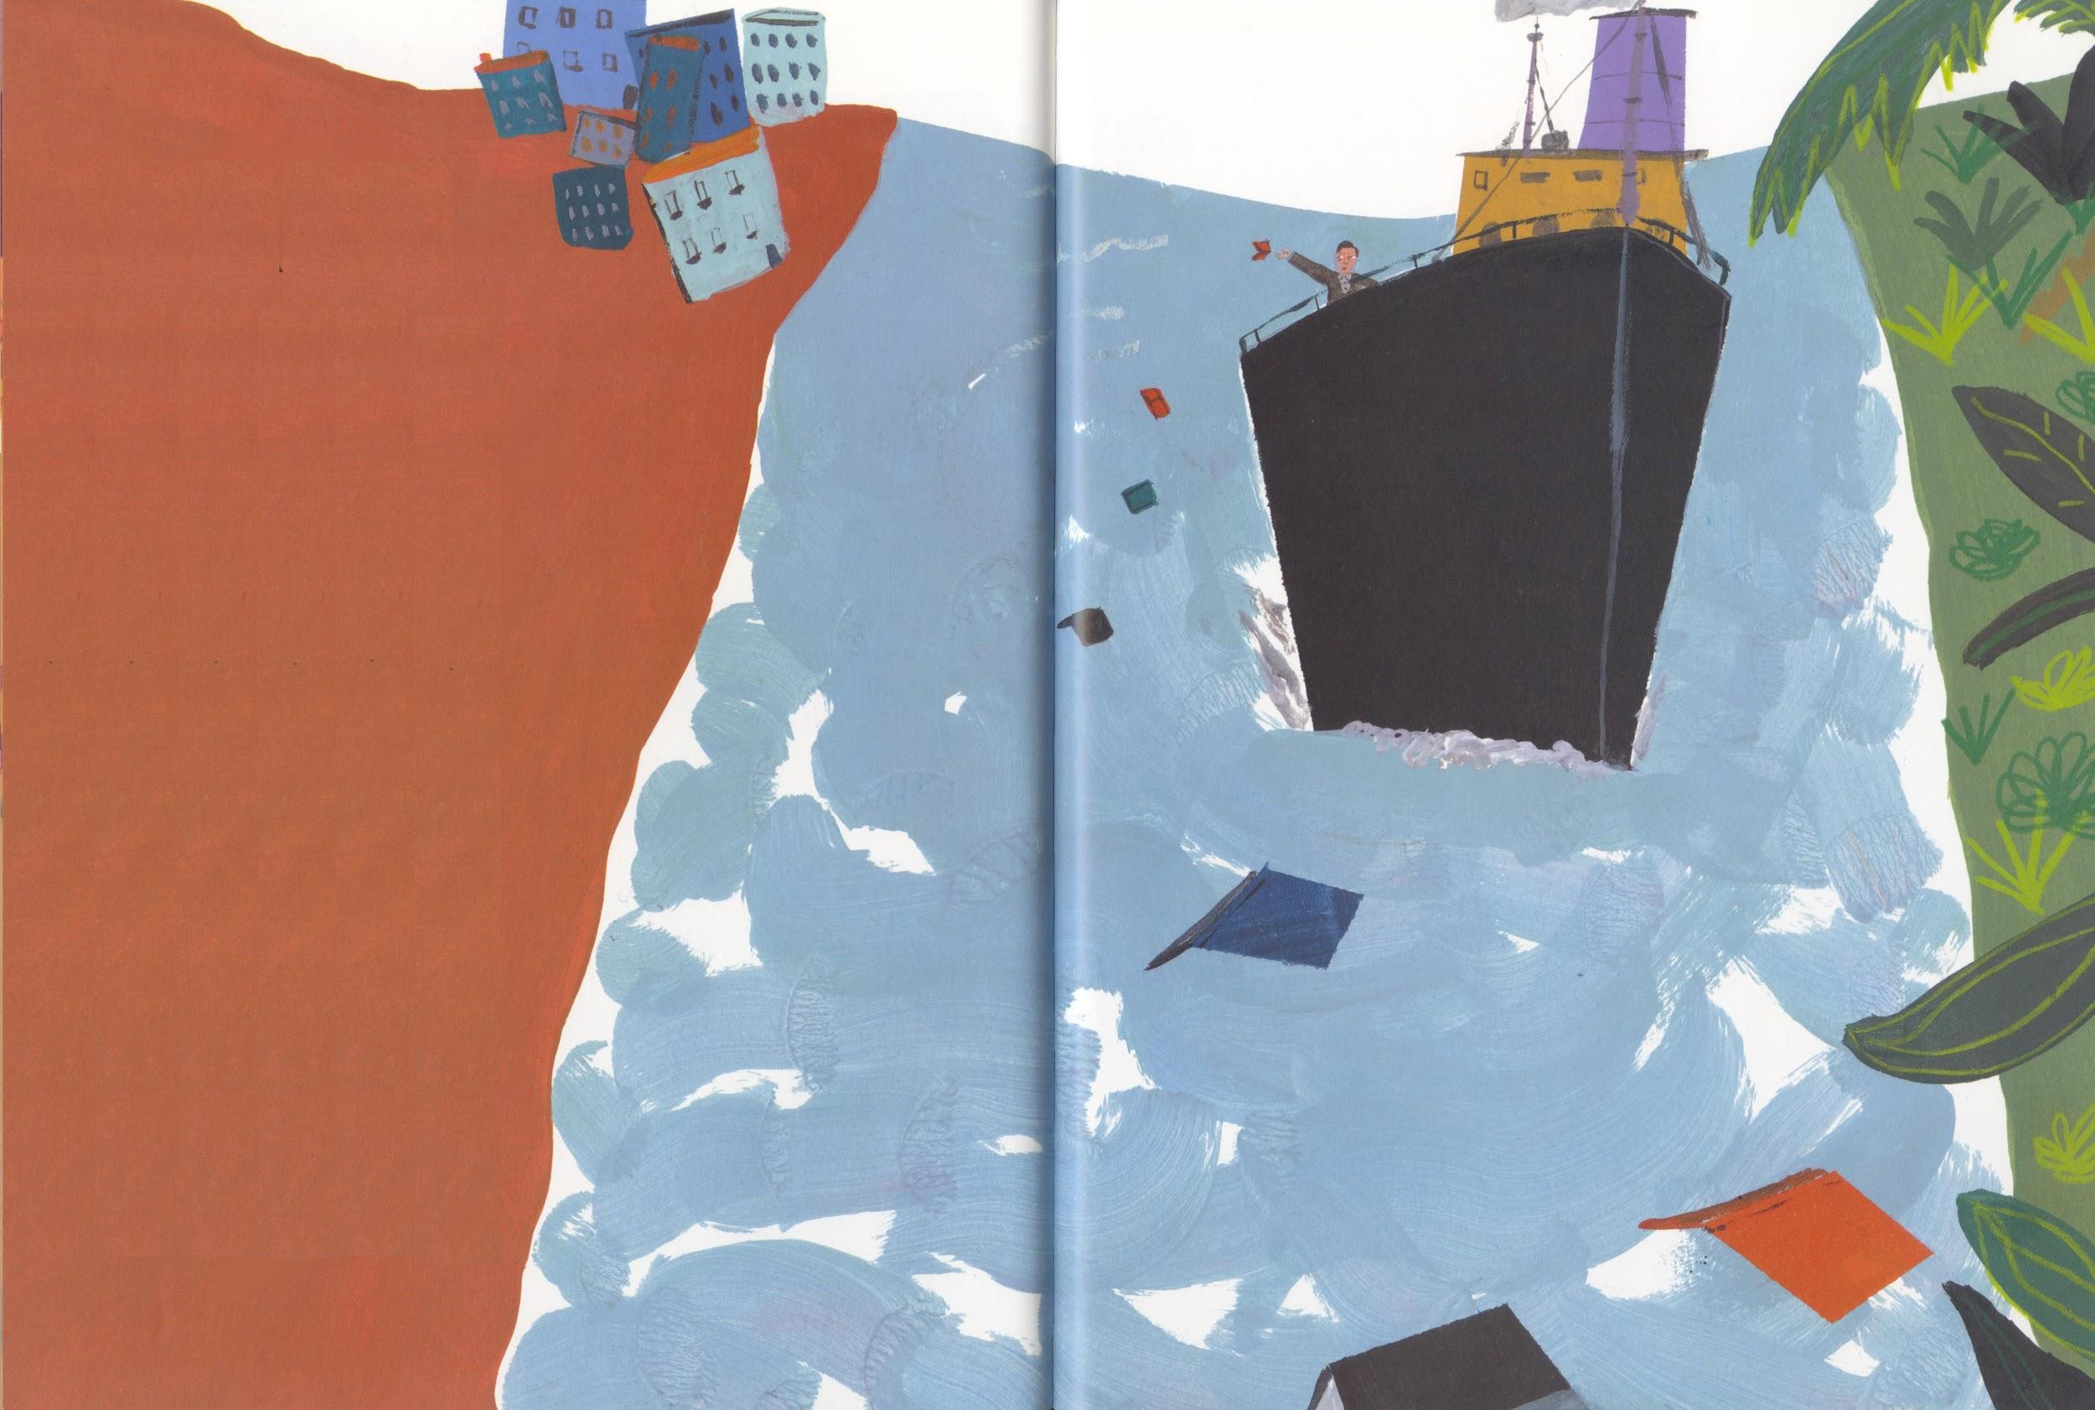
Langston set out to sail the Big Sea,
And visit lots of people who were Black like Me.
Medina, Tony. Love to Langston. Illus. R. Gregory. Lee & Low Books Inc., 2002.

Slide 23
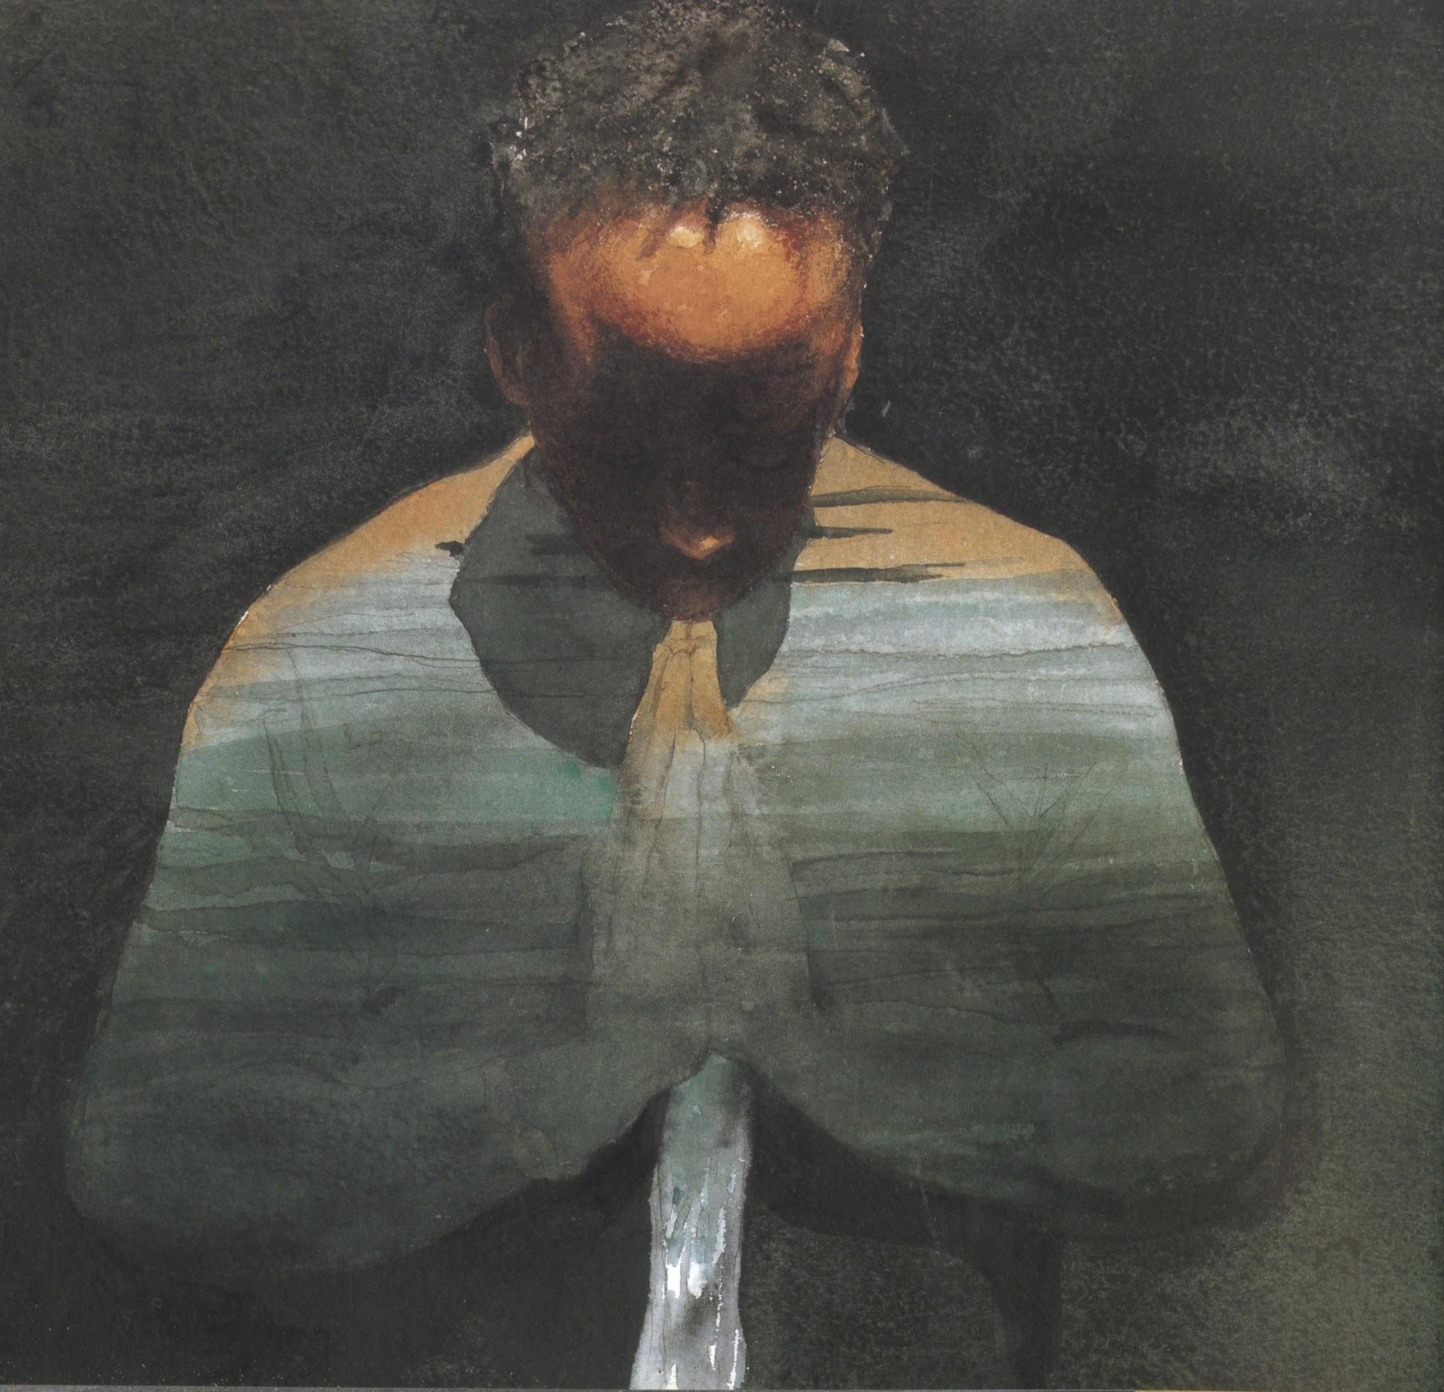
When the Negro Speaks of Rivers, he can talk a while,
Of the Ganges, the Euphrates, Mississippi and the Nile,
Hughes, Langston.The Negro Speaks of Rivers. Illus. E.B. Lewis.
Disney/Jump at the Sun Books, 2009.

Slide 24
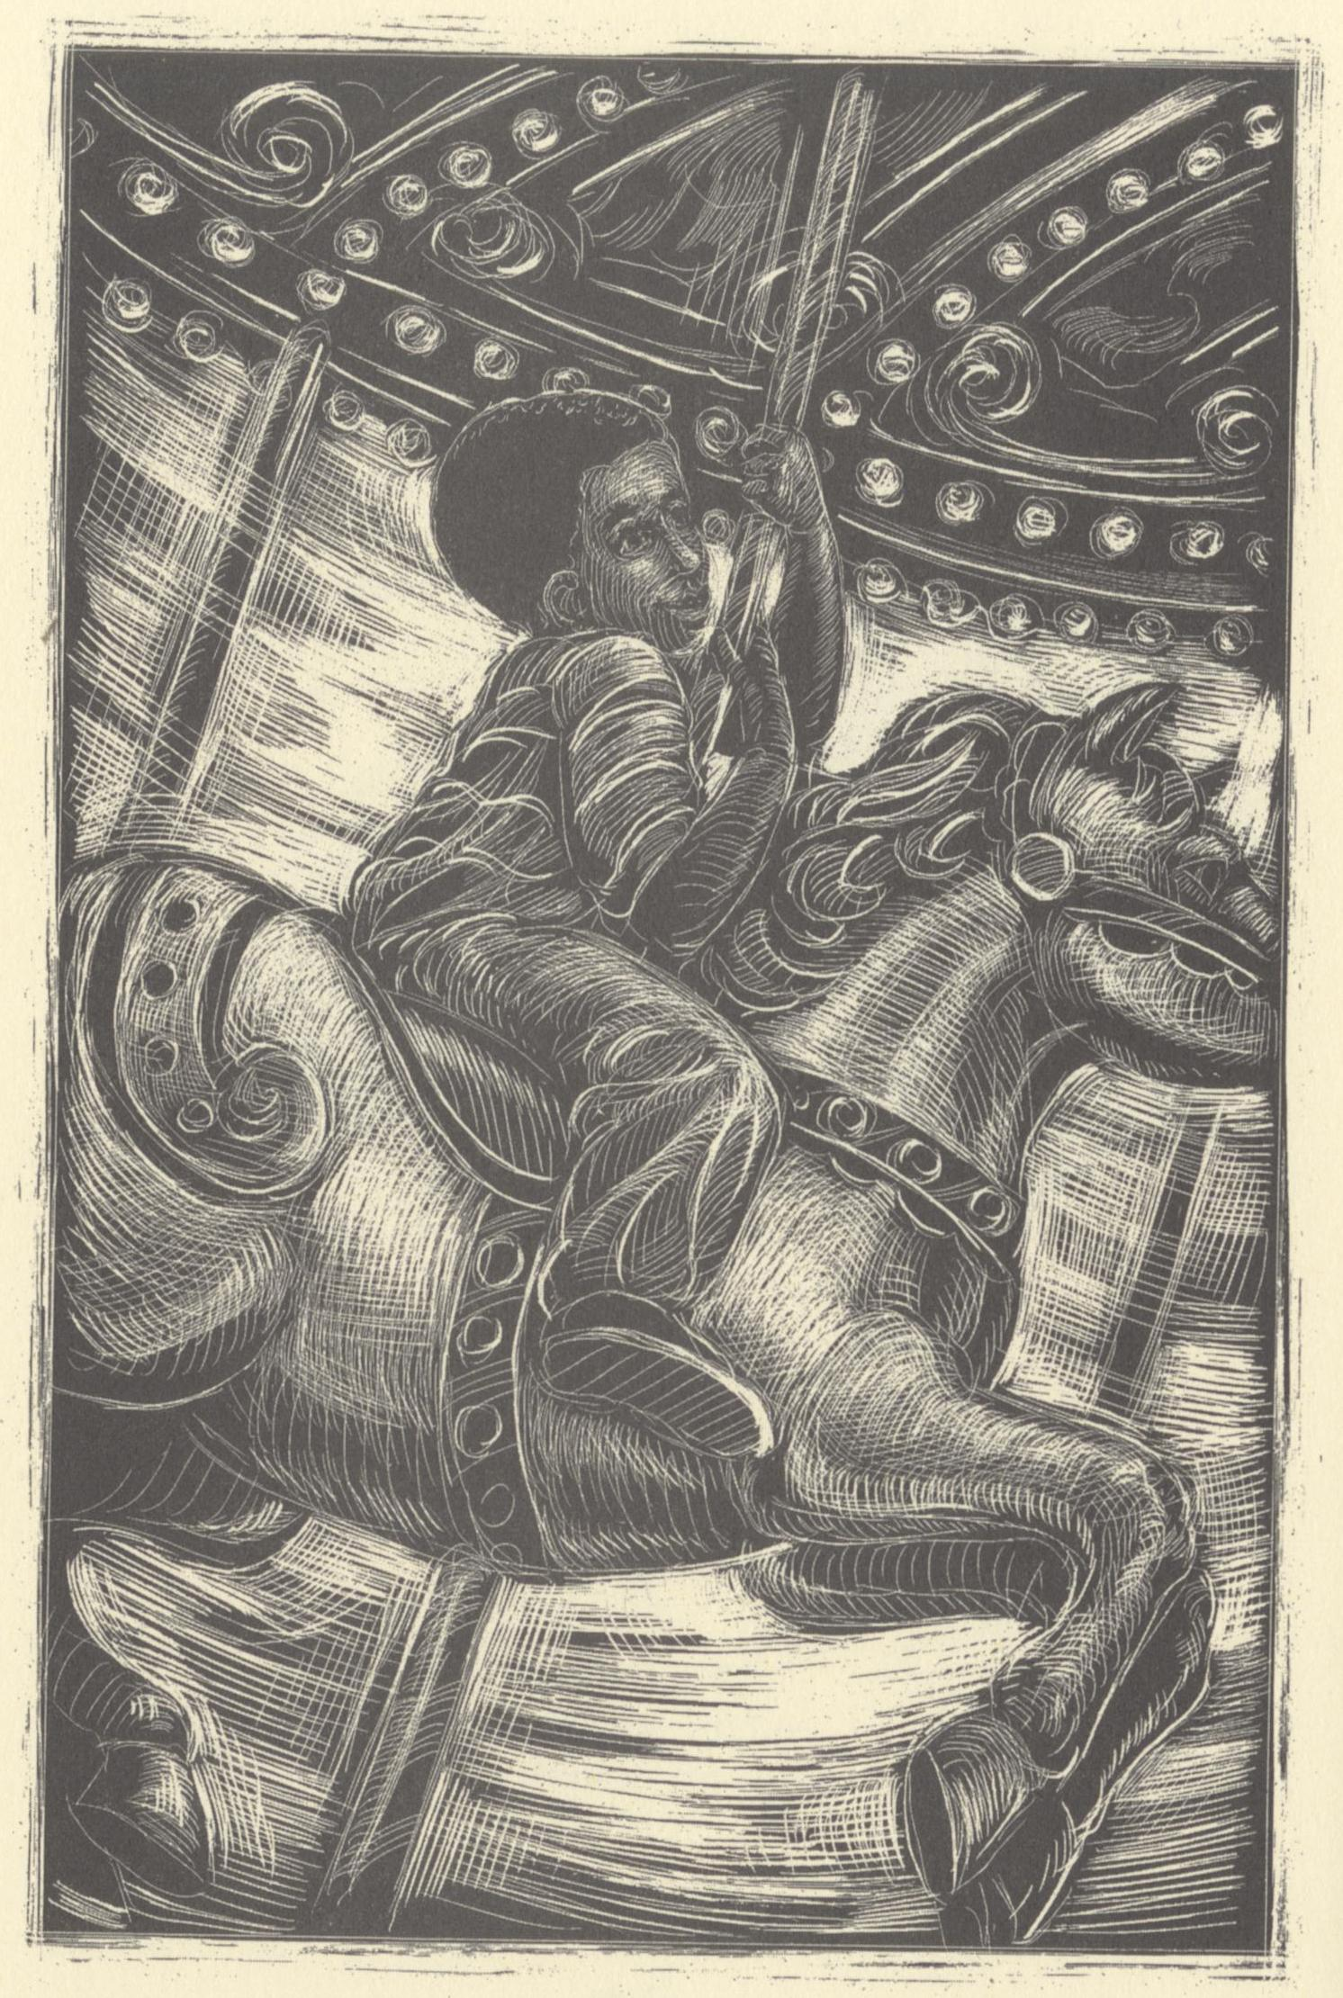
He wrote of a boy who went to town,
And marveled at the people on the merry-go-round,
Hughes, Langston. The Dream Keeper and Other Poems. Illus. Brian Pinkney.
Alfred A. Knopf, 1994.

Slide 25
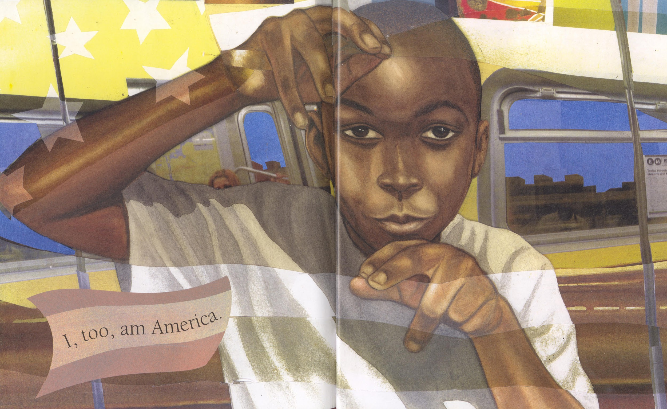
How can I ride, sir, ‘cause there ain’t no back
Is there a Jim Crow section for a kid that’s Black?
Hughes, Langston. I Too Am America. Illus. Bryan Collier.
Simon & Schuster, 2012.

Slide 26
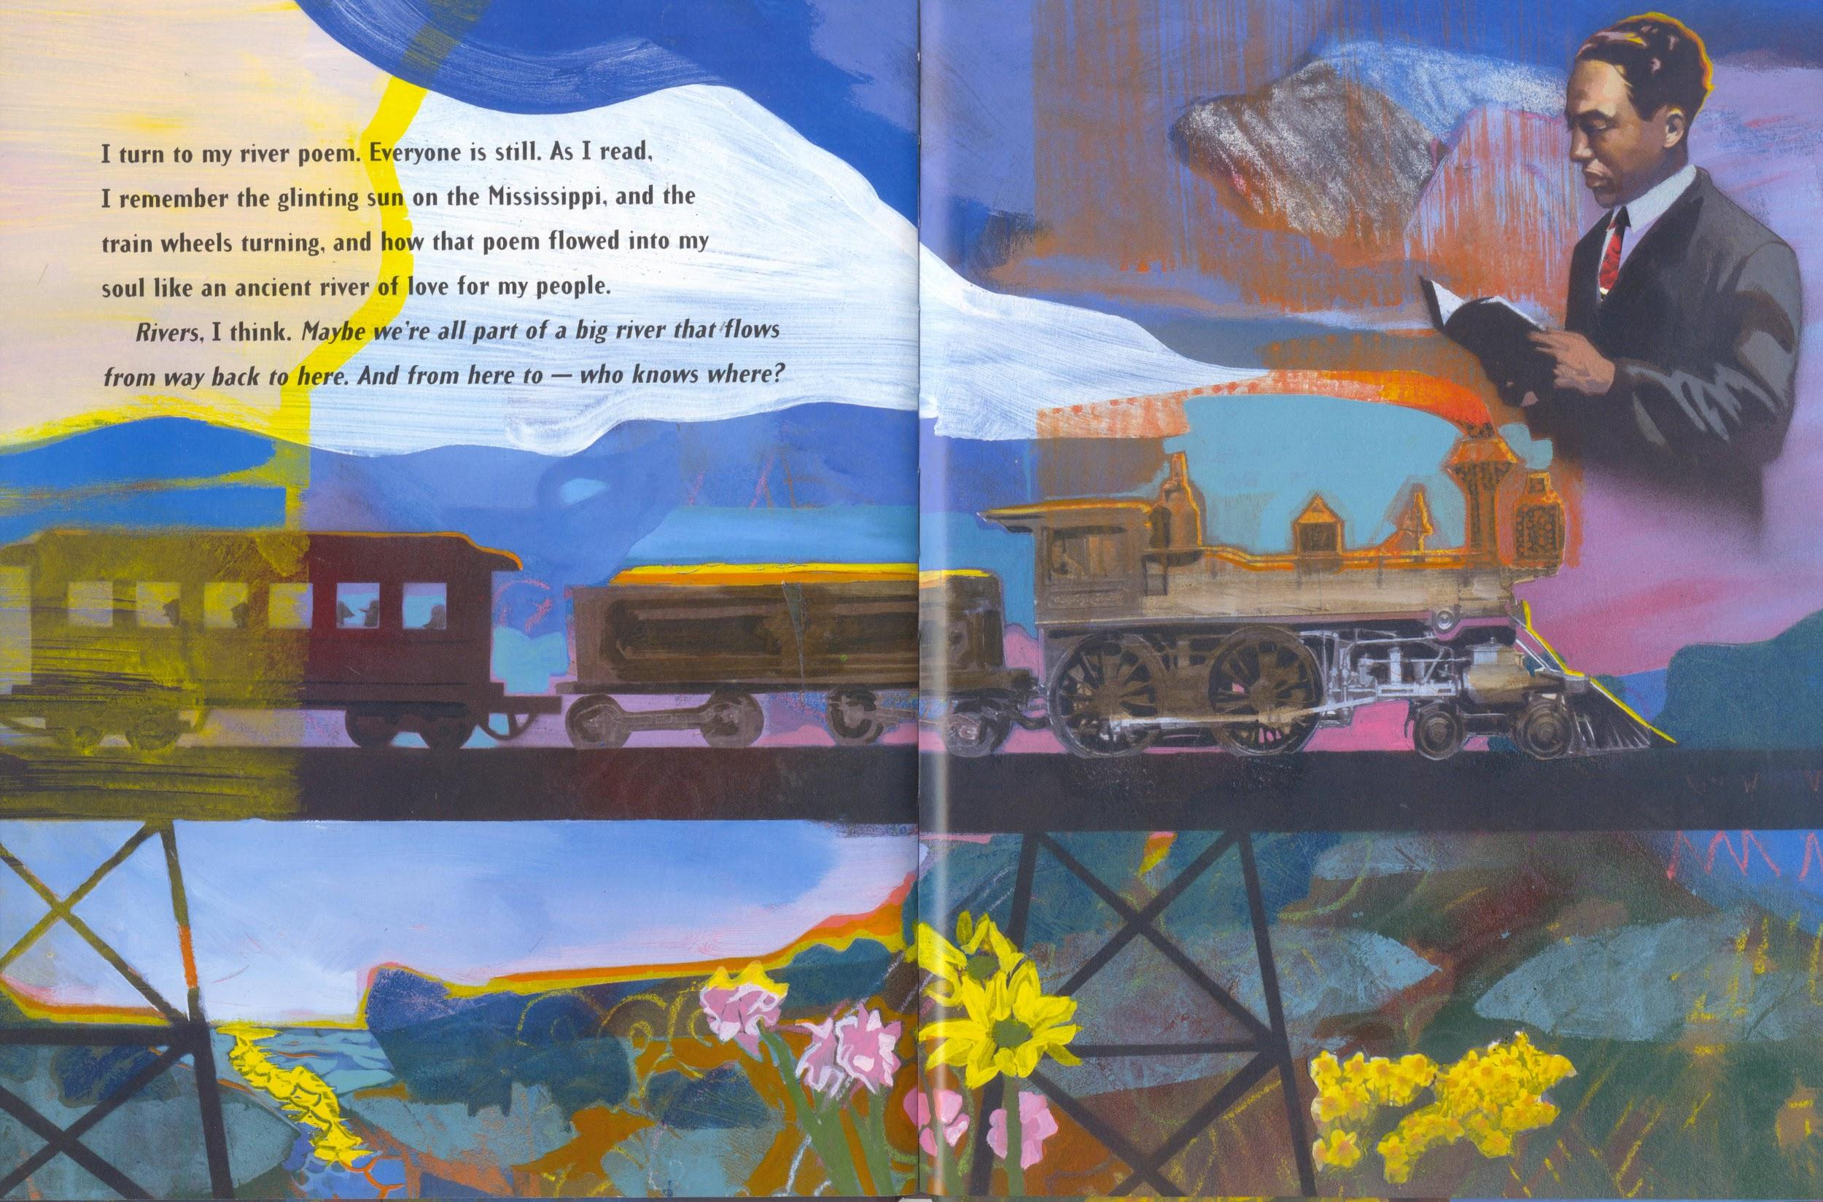
Langston, Langston, Langston Hughes,
Wrote poems for the people and he loved the blues.
Langston, Langston, Langston Hughes,
Wrote poems for the people and he lived the blues.
Jenkins, Leonard. Langston’s Train Ride. Illus. Robert Burleigh.
Orchard Books, 2004.

Slide 27
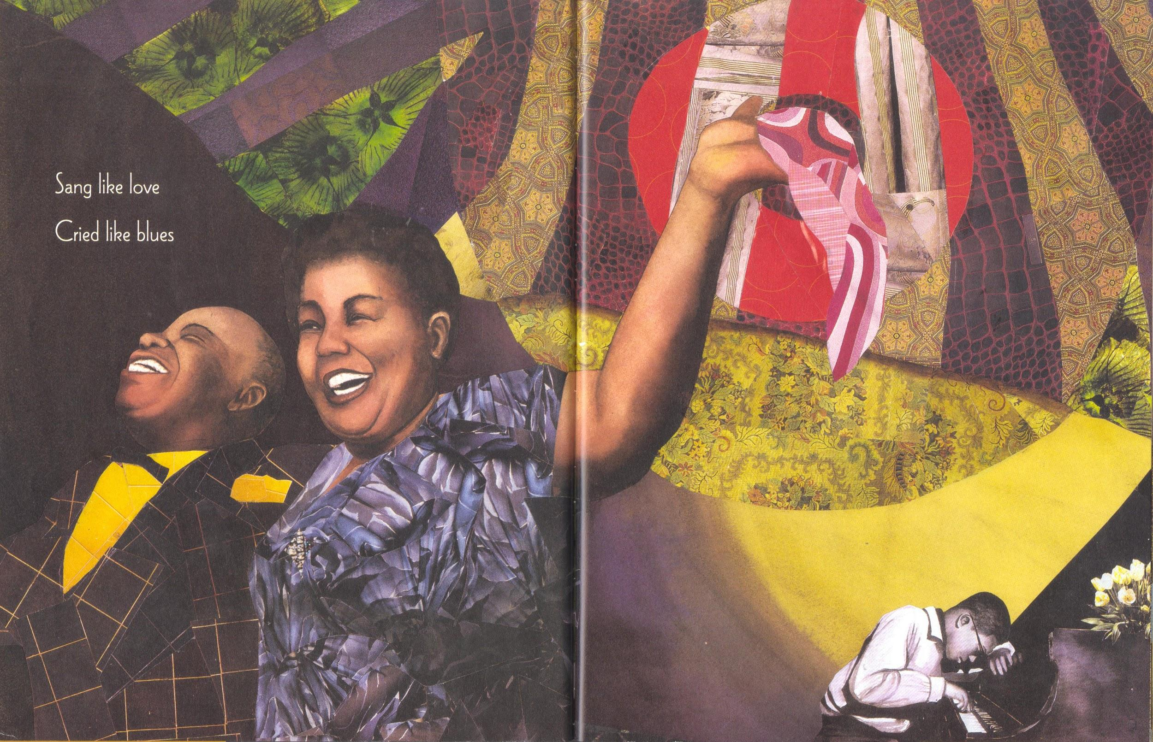
Langston said that jazz makes me sing,
But the blues is my muse that inspires my swing.
Perdomo, Willie. Visiting Langston. Illus. Bryan Collier.
Henry Holt and Company, 2002.

Slide 28
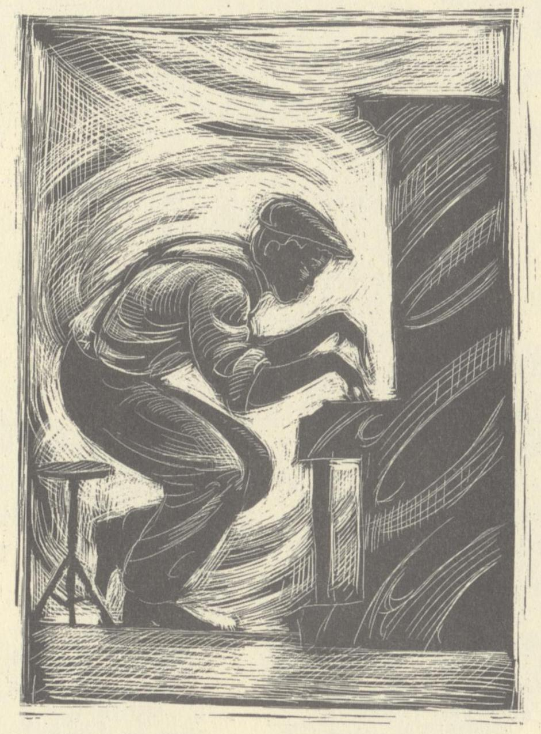
I’m so Black and blue right now,
I wish I could be happy but I don’t know how.
Hughes, Langston. The Dream Keeper and Other Poems. Illus. Brian Pinkney.
Alfred A. Knopf, 1994.

Slide 29
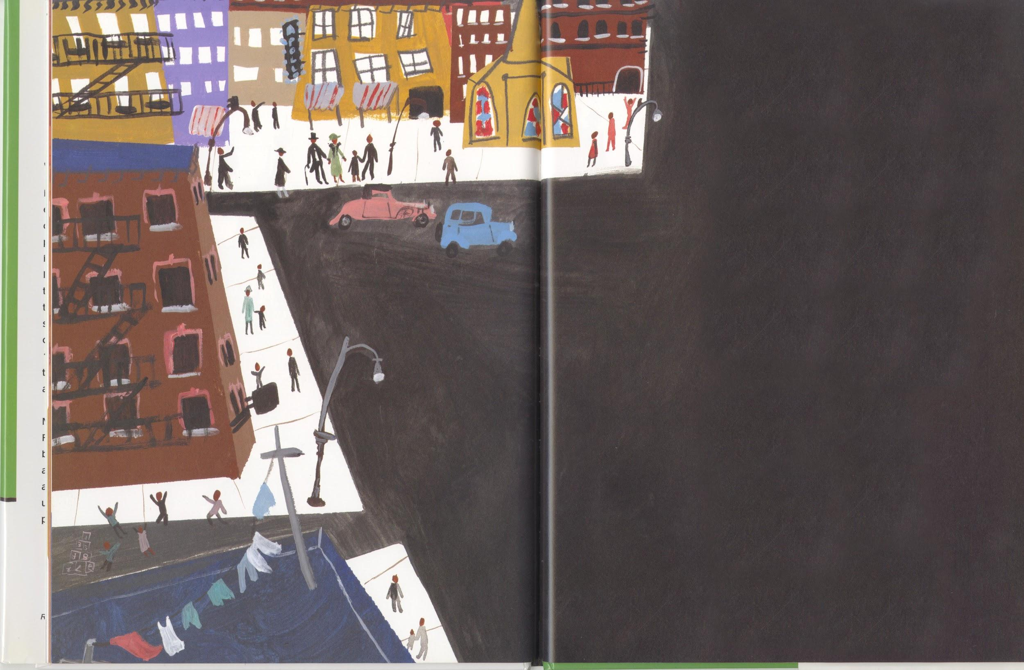
He said Harlem had a soul,
To help Black children grow up brave and bold,
Medina, Tony. Love to Langston. Illus. R. Gregory. Lee & Low Books Inc., 2002.

Slide 30
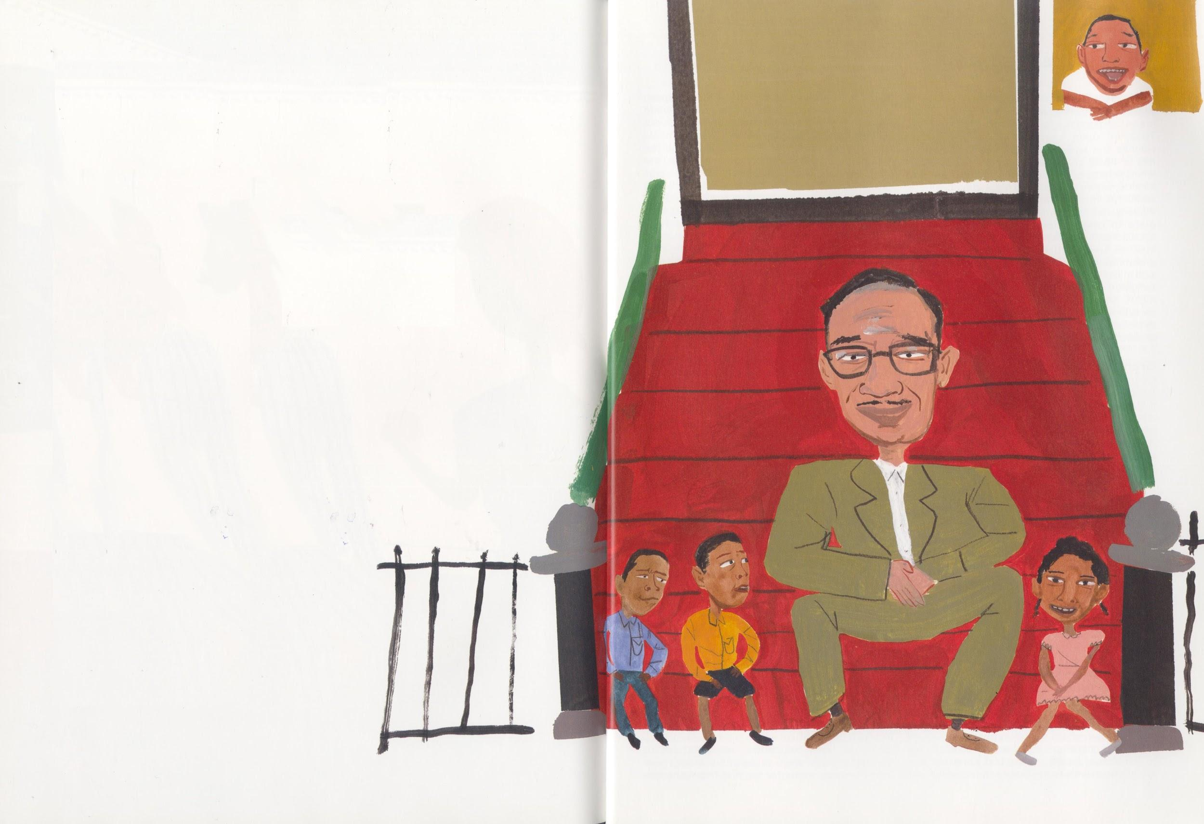
Nurturing talent and paving the way,
From the Harlem Renaissance to the present day.
Medina, Tony. Love to Langston. Illus. R. Gregory. Lee & Low Books Inc., 2002.

Slide 31
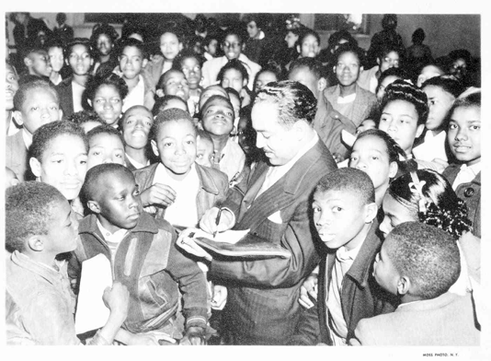
Langston, Langston, Langston Hughes,
Wrote poems for the people and he loved the blues.
Langston, Langston, Langston Hughes,
Wrote poems for the people and he lived the blues.
“Langston Hughes autographing in a group of children, Negro History Week (Atlanta, Georgia), 1947.” Beinecke Rare Book and Manuscript Library, Yale Collection of American Literature, New Haven. Still Image.

Slide 32

The Dark Fantastic: Race and Imagination from Harry Potter to The Hunger Games
Ebony Elizabeth Thomas, New York UP, 2019

Slide 33

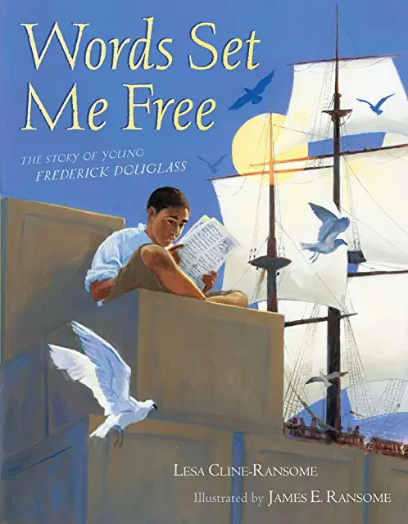

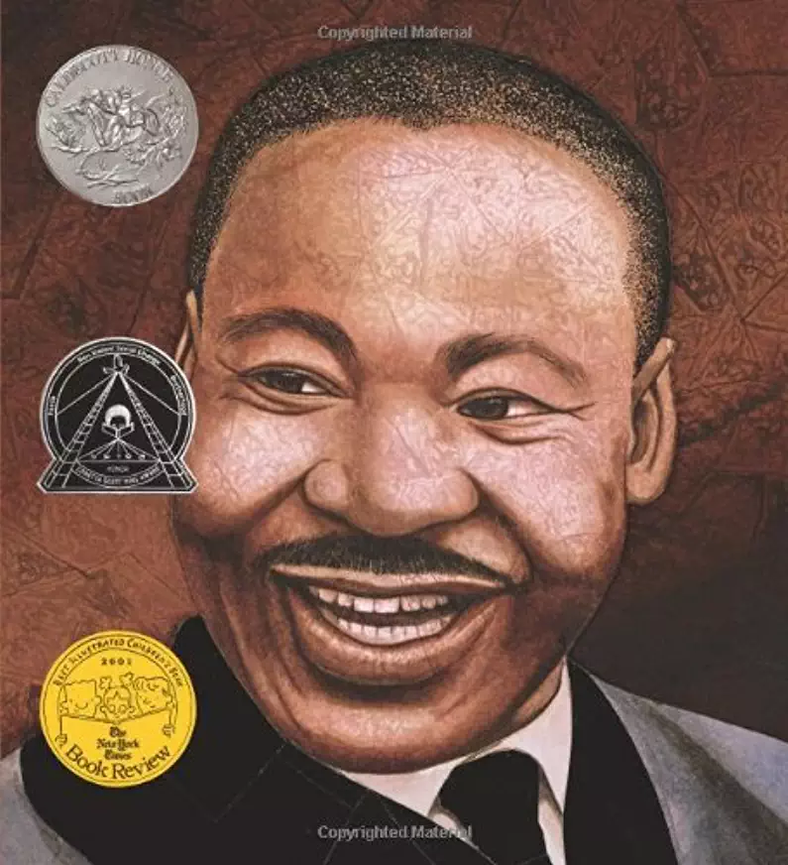
Books Featured in “You’ve Got to Read”
(1997)
(2012)
(1994)
(2001)

Slide 34
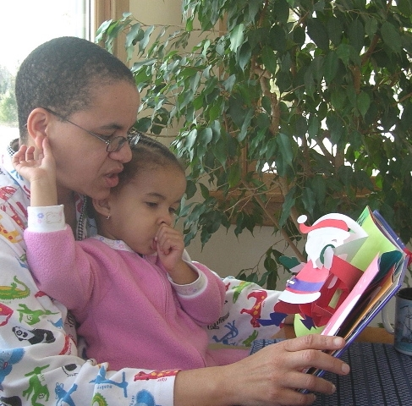
“You’ve Got to Read”
Michelle H. Martin © 2019
Amelia (4 yrs old) and me, reading a Robert Sabuda’s
The Christmas Alphabet pop-up book together

Slide 35
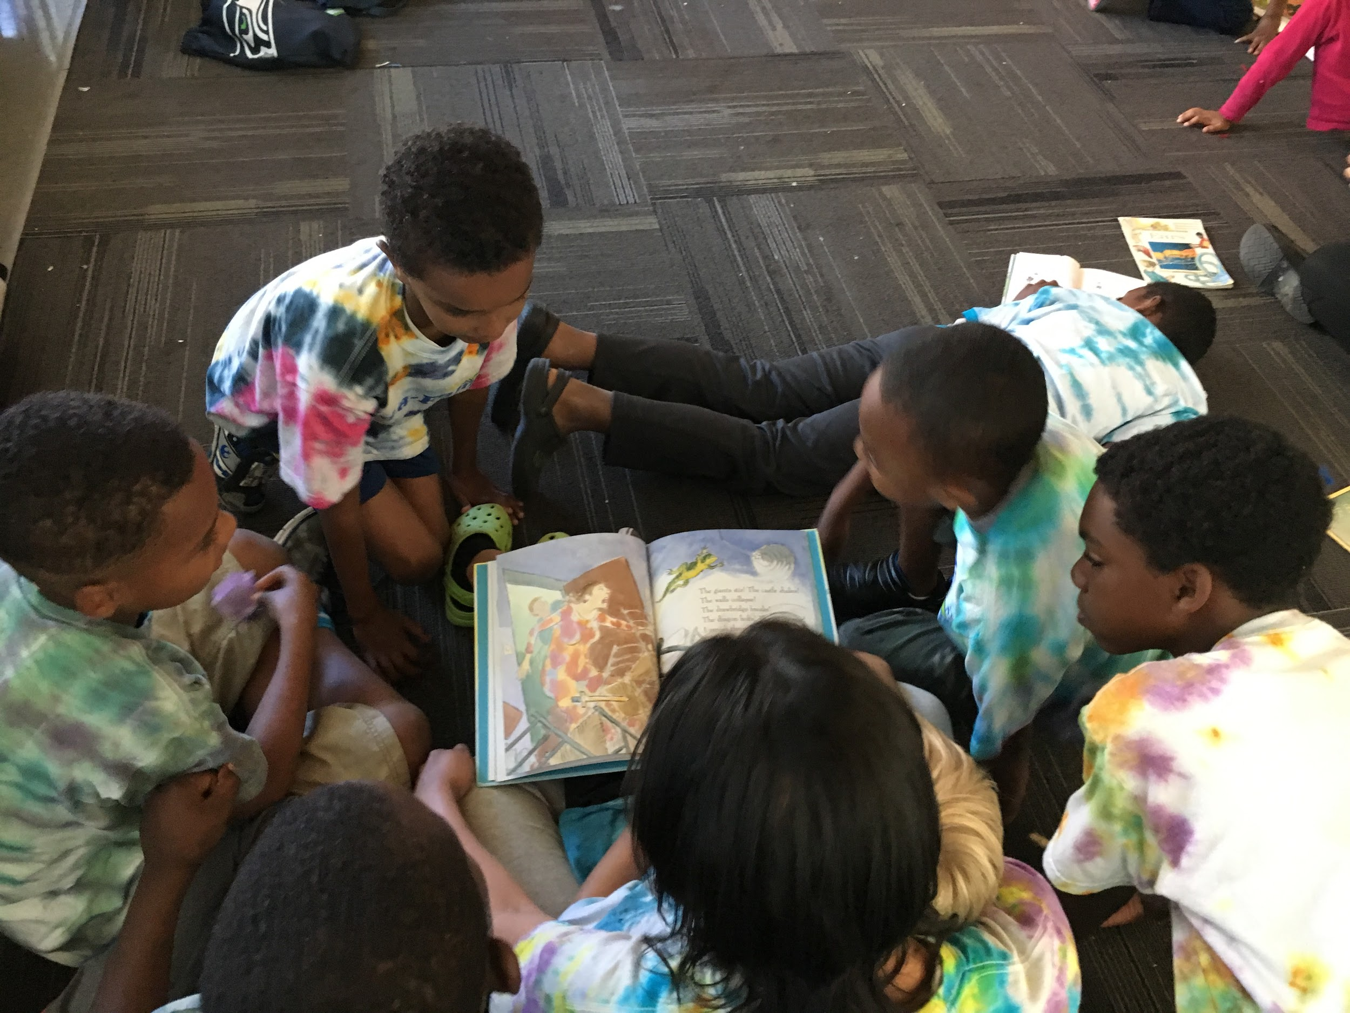
You’ve got to read like your life depends on it,
You’ve got to read something all the time,
You’ve got to read like your life depends on it,
‘Cause books will open up and free your mind.
Camp Read-a-Rama, Seattle, WA, Summer 2017

Slide 36
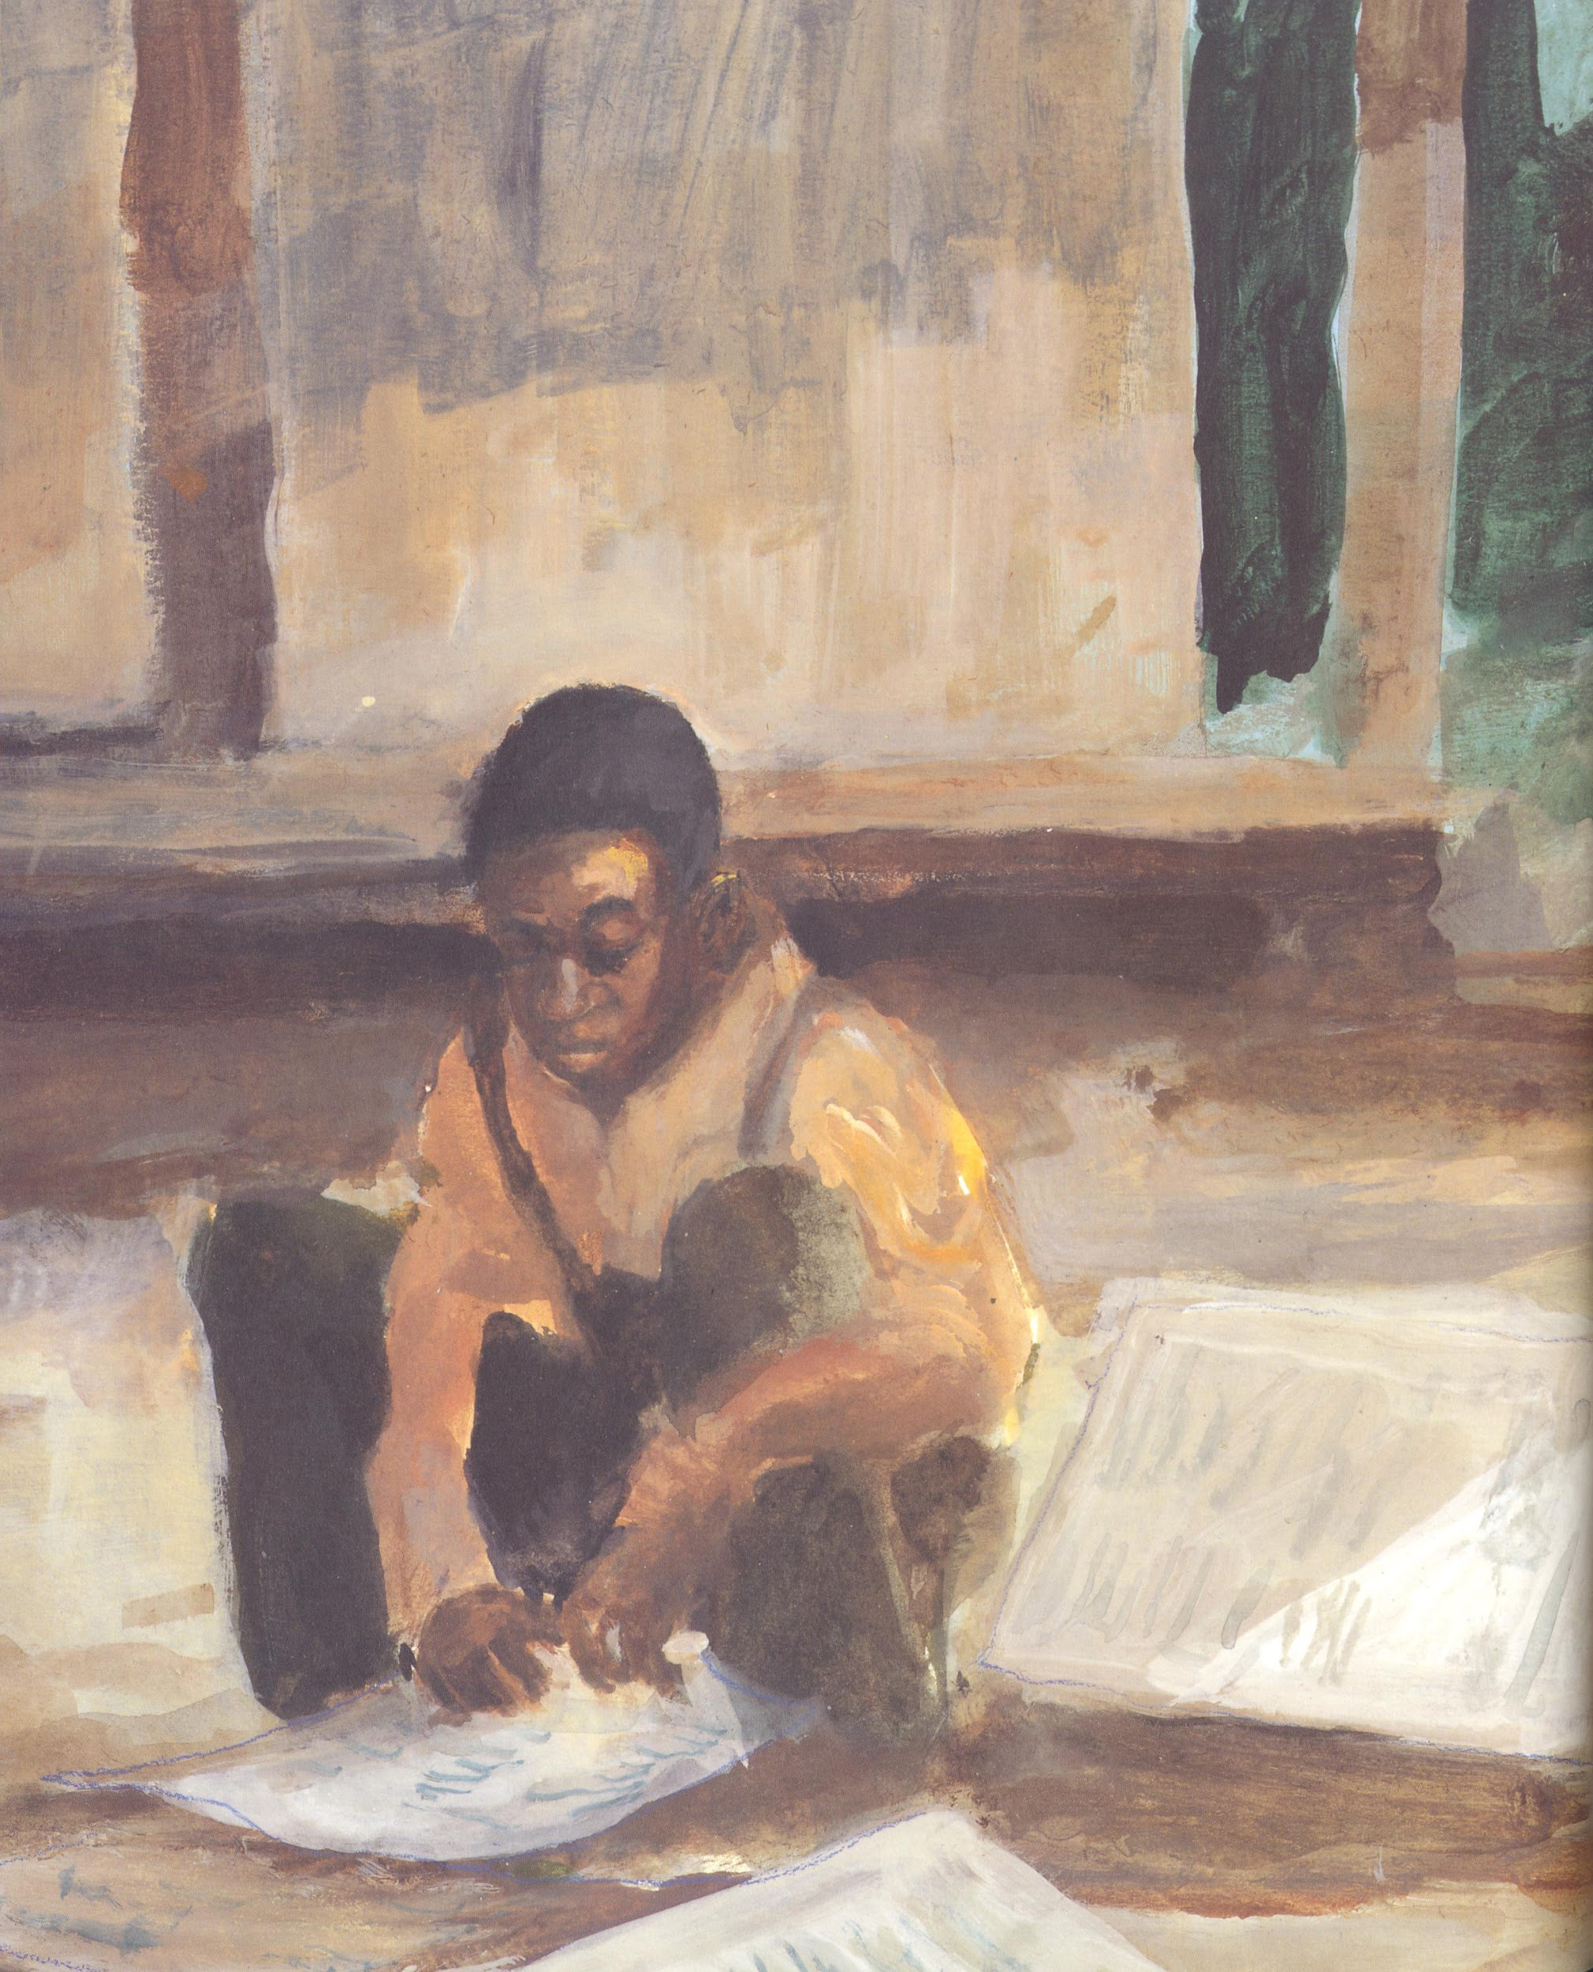
Richard was a poor boy, who sure loved words,
Miller, William. Richard Wright and the Library Card. Illus. R. Gregory Christie.
New York: Lee & Low Books, 1997.

Slide 37
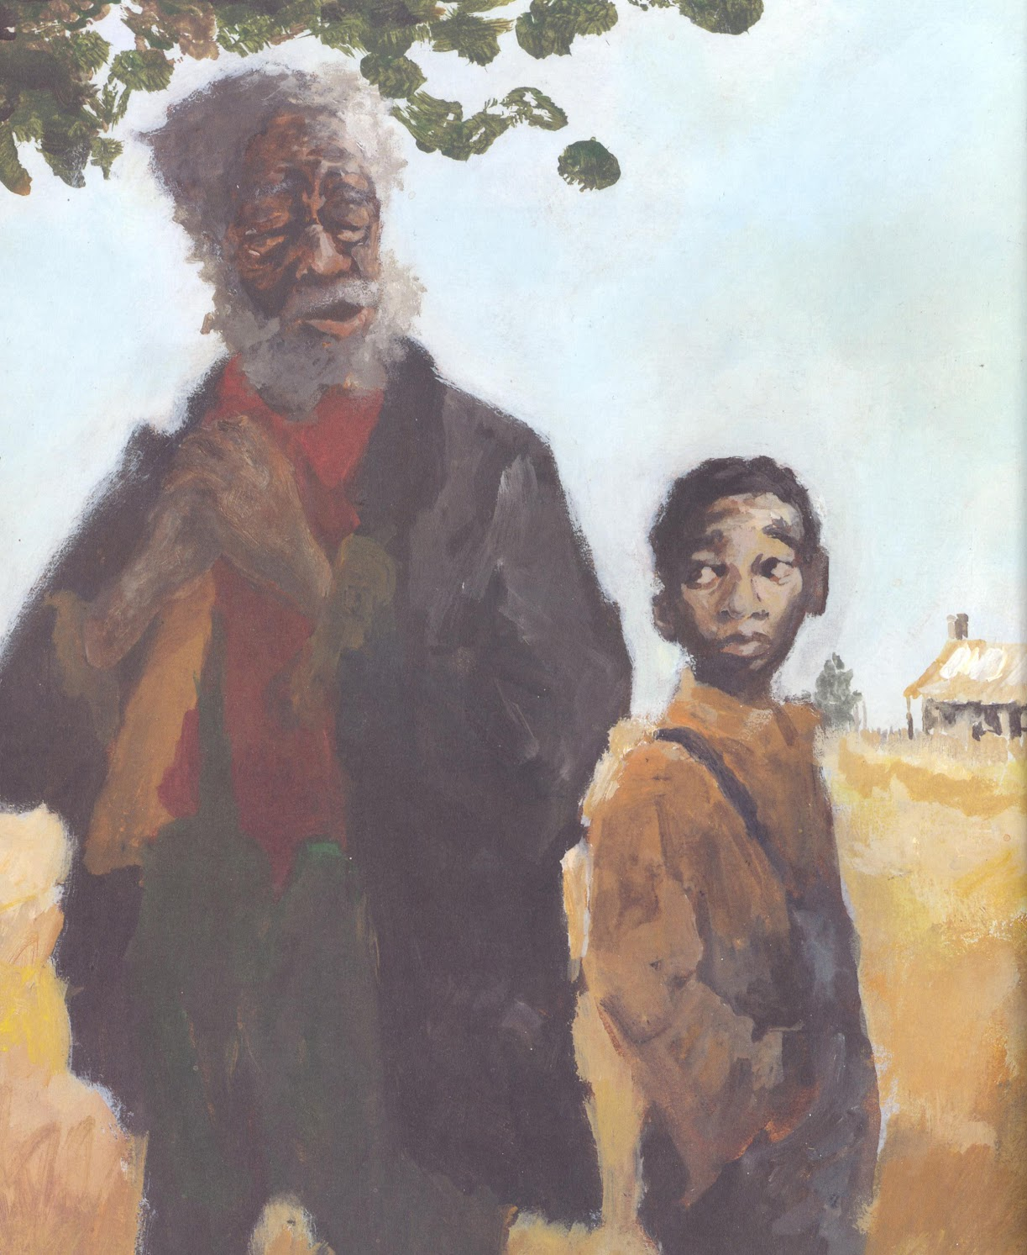
His Grandpa’s stories he would retain,
Miller, William. Richard Wright and the Library Card. Illus. R. Gregory Christie.
New York: Lee & Low Books, 1997.

Slide 38
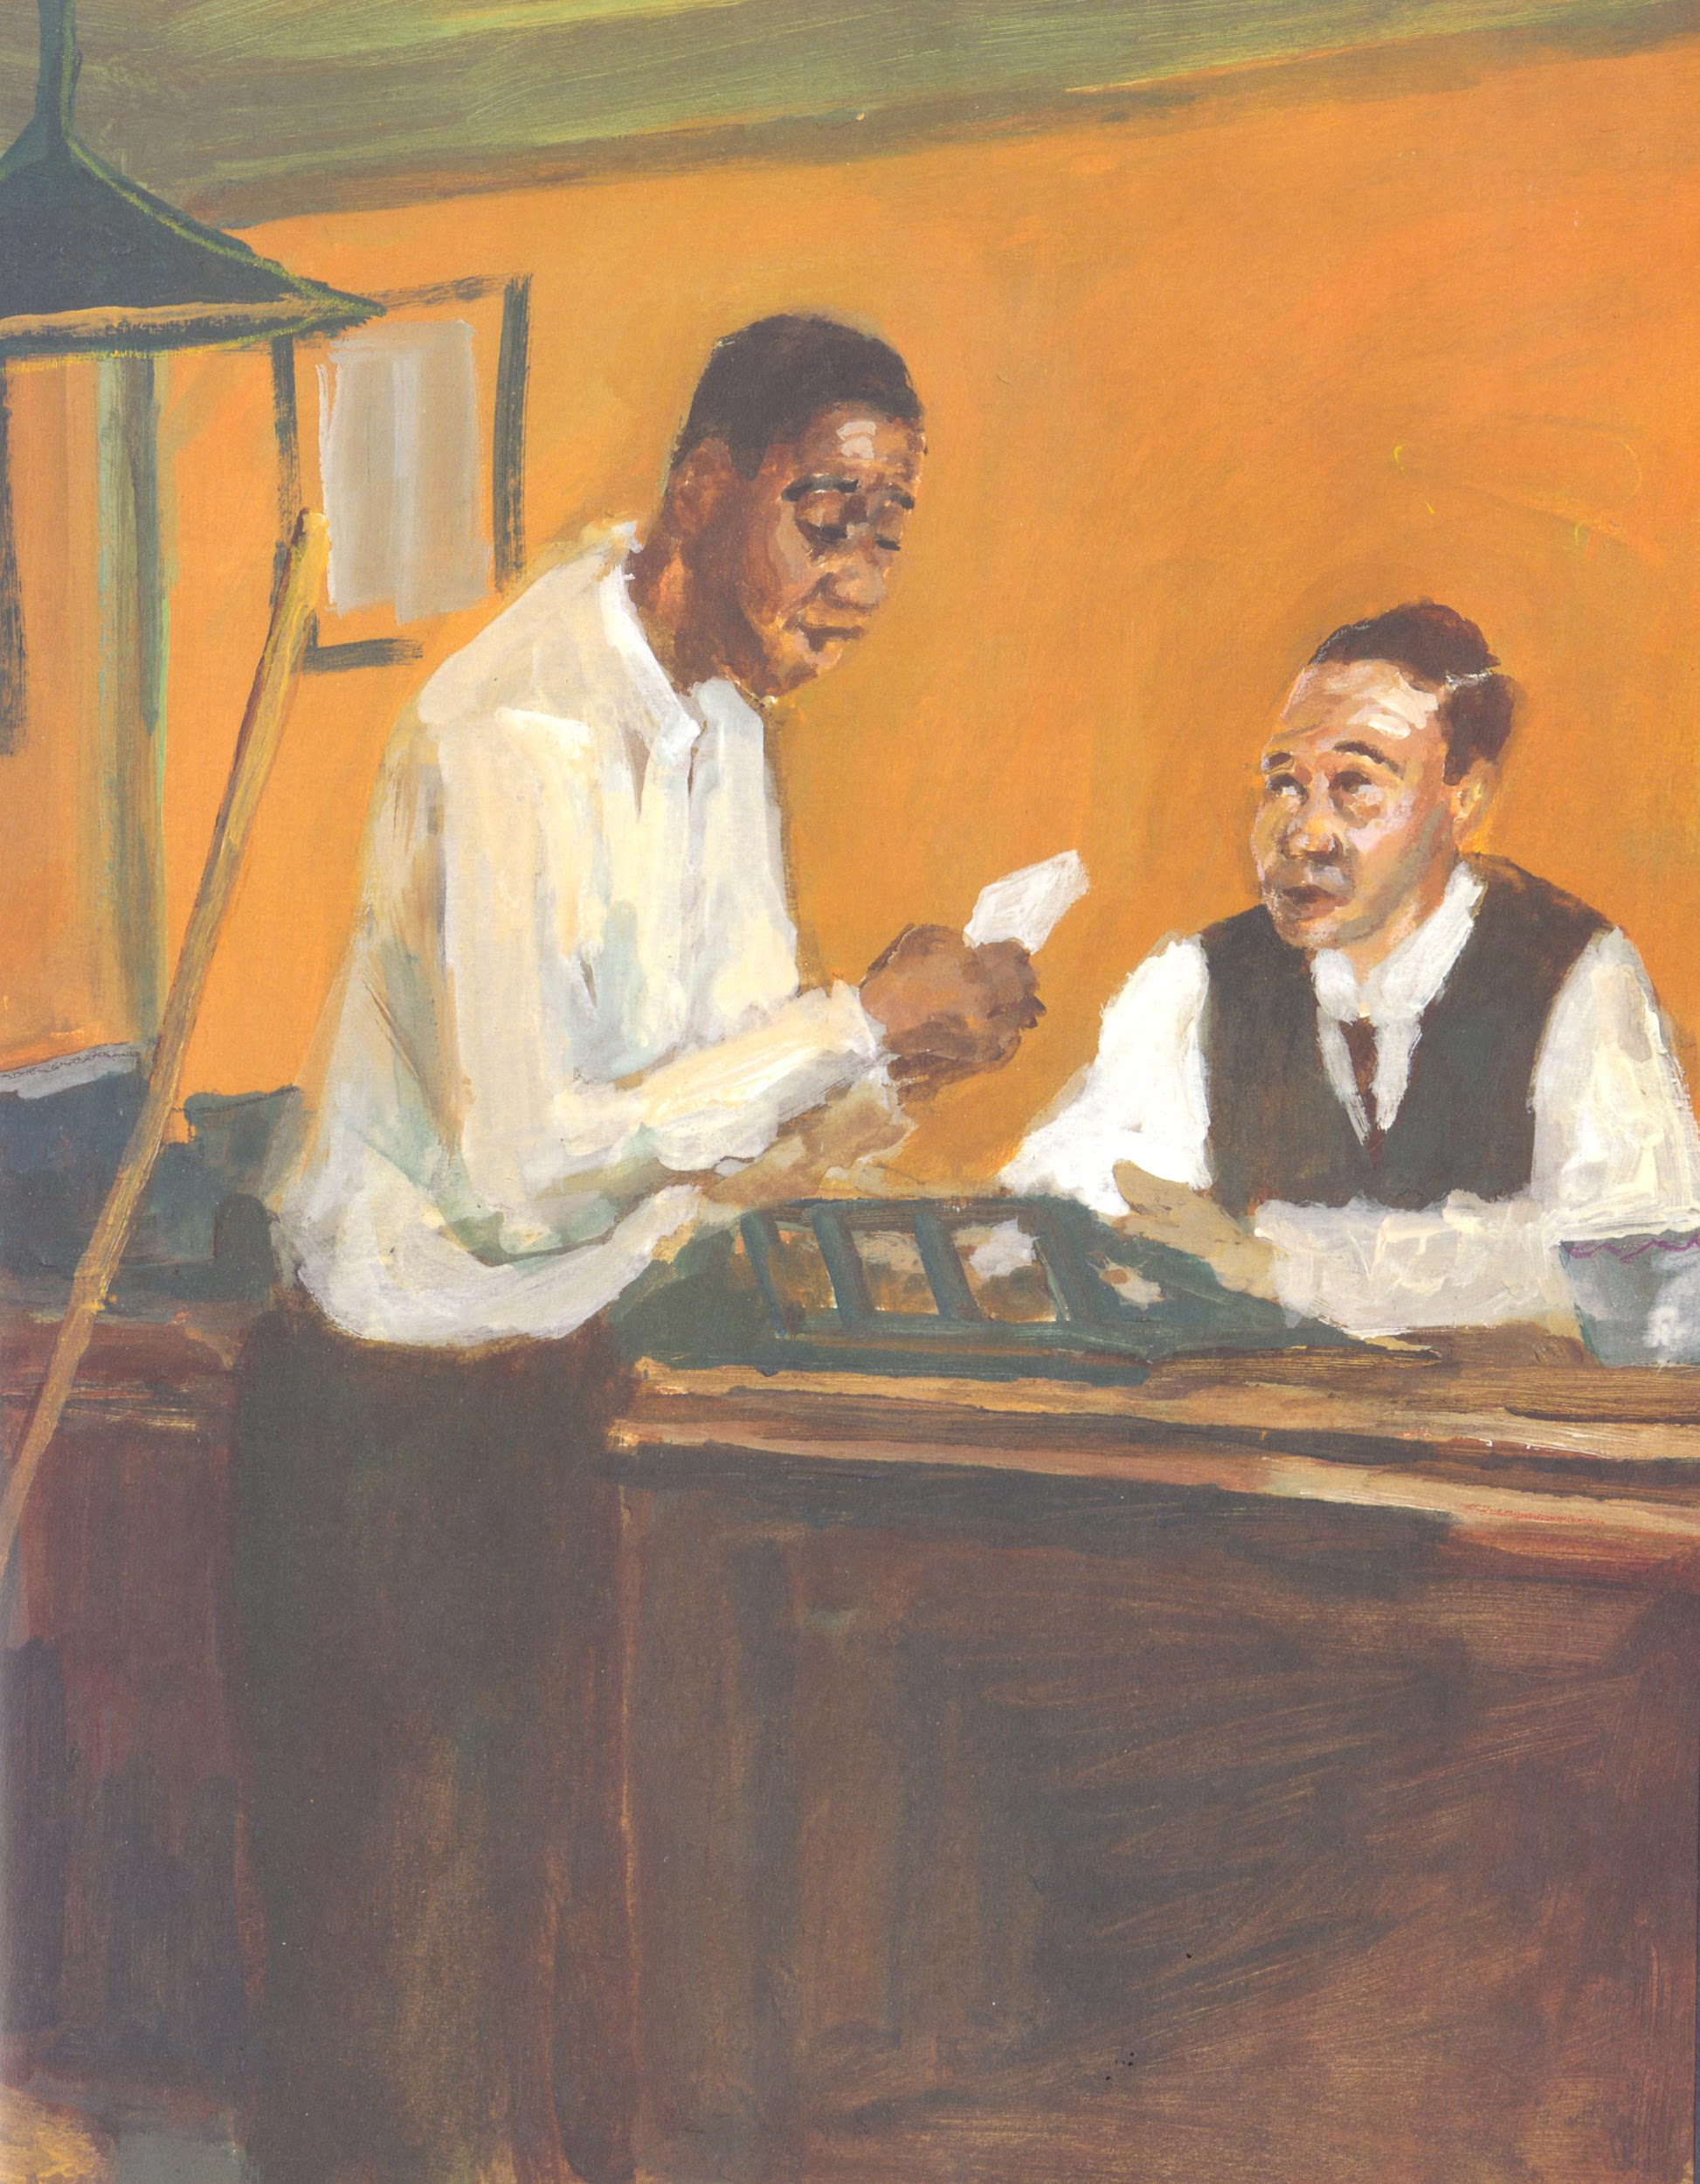
A White man loaned him a library card,
Miller, William. Richard Wright and the Library Card. Illus. R. Gregory Christie.
New York: Lee & Low Books, 1997.

Slide 39

And his life would never be the same.
Miller, William. Richard Wright and the Library Card. Illus. R. Gregory Christie.
New York: Lee & Low Books, 1997.

Slide 40

You’ve got to read like your life depends on it,
You’ve got to read something all the time,
You’ve got to read like your life depends on it,
‘Cause books will open up and free your mind.
Read-a-Rama Earth All Around Us, North Melbourne Library @ Docklands,
Melbourne, Australia, July 2018
iSchool Down Under Study Abroad

Slide 41

Zora had a father who was strict and stern,
Miller, William. Zora Hurston and the Chinaberry Tree. Illus. Cornelius Van Wright and Ying-Hwa Hu. New York: Lee & Low, 1994.

Slide 42

Horizons were her mother’s delight,
Miller, William. Zora Hurston and the Chinaberry Tree. Illus. Cornelius Van Wright and Ying-Hwa Hu.
New York: Lee & Low, 1994.

Slide 43

Zora heard tales told around the fire
To learn that stories keep us alive.
Miller, William. Zora Hurston and the Chinaberry Tree. Illus. Cornelius Van Wright and Ying-Hwa Hu.
New York: Lee & Low, 1994.

Slide 44

You’ve got to read like your life depends on it,
You’ve got to read something all the time,
You’ve got to read like your life depends on it,
‘Cause books will open up and free your mind.
The Reading Tent, Camp Read-a-Rama, Summer 2012
Columbia, South Carolina

Slide 45

Frederick Douglass was a slave, and he knew quite well
How to make the White people see,
Ransome, Lesa-Cline. Words Set Me Free: The Story of Frederick Douglass. Illus. James E. Ransome. New York: Simon & Schuster, 2012.

Slide 46


“Once you learn to read,” even if you’re enslaved,
Ransome, Lesa-Cline. Words Set Me Free: The Story of Frederick Douglass. Illus. James E. Ransome. New York: Simon & Schuster, 2012.

Slide 47

“You will forever be free!”
Ransome, Lesa-Cline. Words Set Me Free: The Story of Frederick Douglass. Illus. James E. Ransome. New York: Simon & Schuster, 2012.

Slide 48

You’ve got to read like your life depends on it,
You’ve got to read something all the time,
You’ve got to read like your life depends on it,
‘Cause books will open up and free your mind.
Read-a-Rama Your Home, My Home, Chorleywood, UK (near London)
Wizards, Whangdoodles & Whizzpoppers Study Abroad, Summer 2017

Slide 49

Martin Luther King spoke some big, bold words,
They bombed his house and threw him in jail,
Rappaport, Doreen. Martin’s Big Words. Illus. Bryan Collier. New York: Scholastic, 2001.

Slide 50

But he read and he wrote and he spoke and sang,
So that peace and harmony would prevail.
Rappaport, Doreen. Martin’s Big Words. Illus. Bryan Collier. New York: Scholastic, 2001.

Slide 51

You’ve got to read like your life depends on it,
You’ve got to read something all the time,
You’ve got to read like your life depends on it,
‘Cause books will open up and free your mind.
Read-a-Rama Science Fun, Seattle, Spring 2017

Slide 52




Camp Read-a-Rama 2010, Clemson
Camp Read-a-Rama 2011, Clemson
Camp Read-a-Rama 2012, Clemson
Camp Read-a-Rama 2013, Columbia

Slide 53

Peter’s Song
Keats, Ezra Jack. The Snowy Day. New York: Viking, 1962.

Slide 54






Books Featured in Peter’s Song

Slide 55

My Name is Peter, and I love my dog,
Keats, Erza Jack. Whistle for Willie. New York: Viking, 1964.

Slide 56

When I whistle for Willie, he comes right along.
Keats, Erza Jack. Whistle for Willie. New York: Viking, 1964.

Slide 57

He’s black and he’s brown, and he’s low to the ground
Keats, Erza Jack. Whistle for Willie. New York: Viking, 1964.

Slide 58

When he’s looking for me, I’m happy to be found
Keats, Erza Jack. Whistle for Willie. New York: Viking, 1964.

Slide 59

What makes the snow disappear from my pocket overnight?
Keats, Ezra Jack. The Snowy Day. New York: Viking, 1962.

Slide 60

When can I go out to play?
Keats, Ezra Jack. The Snowy Day. New York: Viking, 1962.

Slide 61

‘Cause when I turn my toes like this,
and I turn my toes like that,
Surely they will lead me somewhere.
Keats, Ezra Jack. The Snowy Day. New York: Viking, 1962.

Slide 62
I have a sister, and she has a chair
Keats, Ezra Jack. Peter’s Chair. New York: Viking, 1998.

Slide 63

That used to be mine, but now she will sit there.
Keats, Ezra Jack. Peter’s Chair. New York: Viking, 1998.

Slide 64

My cradle’s now pink; it’s a plain as this day . . .
Keats, Ezra Jack. Peter’s Chair. New York: Viking, 1998.

Slide 65

It’s time to call Willie so we can run away!
Keats, Ezra Jack. Peter’s Chair. New York: Viking, 1998.

Slide 66

What makes the snow disappear from my pocket overnight?
When can I go out to play?
‘Cause when I turn my toes like this,
and I turn my toes like that,
Surely they will lead me somewhere.
Keats, Ezra Jack. The Snowy Day. New York: Viking, 1962.

Slide 67

Louie, Roberto, the Man in the Moon
Keats, Erza Jack. Regards to the Man in the Moon. Aladdin Books, 1987.

Slide 68

Jennie and Maggie will come to play soon,
Keats, Erza Jack. Dreams. New York: Macmillan Publishing, 1974.

Slide 69

Keats made these mirrors and windows for me,
Keats, Erza Jack. Goggles. New York: Aladdin Paperbacks, 1969.

Slide 70

Starting with Peter, under a snow-covered tree.
Pinkney, Andrea Davis. A Poem for Peter. Illus. Lou Fancher and Steve Johnson. New York: Viking, 2016.

Slide 71

What makes the snow disappear from my pocket overnight?
When can I go out to play?
‘Cause when I turn my toes like this,
and I turn my toes like that,
Surely they will lead me somewhere.
Pinkney, Andrea Davis. A Poem for Peter. Illus. Lou Fancher and Steve Johnson. New York: Viking, 2016.

Slide 72

My name is Ezra, and I had a dream
Pinkney, Andrea Davis. A Poem for Peter. Illus. Lou Fancher and Steve Johnson. New York: Viking, 2016.

Slide 73

To take that boy, Peter, from Life Magazine,
Pinkney, Andrea Davis. A Poem for Peter. Illus. Lou Fancher and Steve Johnson. New York: Viking, 2016.

Slide 74

And paint him on pages for brown kids to see,
Pinkney, Andrea Davis. A Poem for Peter. Illus. Lou Fancher and Steve Johnson. New York: Viking, 2016.

Slide 75

That books are for kids who look a lot like me.
Pinkney, Andrea Davis. A Poem for Peter. Illus. Lou Fancher and Steve Johnson. New York: Viking, 2016.

Slide 76
What makes the snow disappear from my pocket overnight?
Keats, Ezra Jack. The Snowy Day. New York: Viking, 1962.

Slide 77
When can I go out to play?
Keats, Ezra Jack. The Snowy Day. New York: Viking, 1962.

Slide 78
‘Cause when I turn my toes like this,
and I turn my toes like that,
Surely they will lead me somewhere.
Keats, Ezra Jack. The Snowy Day. New York: Viking, 1962.

Slide 79

Surely they will lead me somewhere . . .
Keats, Ezra Jack. The Snowy Day. New York: Viking, 1962.

Slide 80

Read-a-Rama Science Fun
Clemson, SC 2009

Slide 81

Read-a-Rama Splashdown
Clemson, SC, Summer Camp 2010

Slide 82

Dr. Rachelle D. Washington (Bowling discussion)
Clemson, SC, Summer Camp 2010

Slide 83

Read-a-Rama Let’s Have a Ball (All Things Round)
Performing books, Clemson, SC, Summer Camp 2010

Slide 84



Booker, the Read-a-Rama Bookworm

Slide 85

Read-a-Rama Spooktacular
Michelle Martin playing guitar for families & her students @ Read-a-Rama Spooktacular,
Richland Library, Columbia, SC, Fall 2015

Slide 86

Read-a-Rama Rocks (Geology & Music)
Richmond Beach, WA, Summer Camp 2017

Slide 87
THANKS!
Nate Bogopolsky, Music in the Stacks with Style - Music Coach
Mike Eisenberg, former iSchool Dean - Guitar Coach
Molly Barnes, BFL Music Director - Vocal Coach
Andrew McKenna Foster, iSchool GA Crew - Tech Support
J. Elizabeth Mills - Beverly Cleary GA
Amelia Hare - my daughter
Lee Talley - ChLA Songbird
Libby Gruner - ChLA Songbird
Ngozi Onuorah - On-site Tech Support

Slide 88
Big Blue Marble by Michelle H. Martin @1989
We will love the earth wherever we roam,
For this Big Blue Marble is our home,
And we know that everyone in it,
And we know that everything in it
Will always be a part of who we are.
Substitute “the earth” for:
Tall trees Green grass The sun The moon

Slide 89
Works Cited
Baby Go Bye-Bye. Feeling Retro. http://www.feelingretro.com/toys/Girl-Toys/baby-go-bye-bye.php. Accessed 26 Oct. 2019
Brownies’ Book Magazine. July 1920. http://childlit.unl.edu/topics/edi.brownies.html
"Children's Books as a Radical Act." Reflection Press, www.reflectionpress.com/childrens-books-radicalact/. Accessed 12 Sept. 2019.
Cooper, Floyd. Coming Home: From the Life of Langston Hughes. Philomel, 1994.
Delgado, Richard and Jean Stefancic. Critical Race Theory: An Introduction. New York University Press, 2001.
DiAngelo, Robin. White Fragility: Why It’s So Hard for White People to Talk About Racism. Beacon Press, 2018.
Hughes, Langston. The Dream Keeper and Other Poems. Illustrated by Helen Sewell, Alfred A. Knopf, 1932.
---. The Dream Keeper and Other Poems. Illustrated by Brian Pinkney, Alfred A. Knopf, 1994.
---.. The Negro Speaks of Rivers. Illustrated by E.B. Lewis, Disney/Jump at the Sun Books, 2009.
---. I, Too, Am America. Illustrated by Bryan Collier, Simon & Schuster, 2012.
Jenkins, Leonard. Langston’s Train Ride. Illustrated by Robert Burleigh, Orchard Books, 2004.
Keats, Ezra Jack. The Snowy Day. Viking, 1962.
---. Whistle for Willie. Viking, 1964.
---. Goggles. Aladdin Paperbacks, 1969.
---. Dreams. Macmillan Publishing, 1974.
---. Regards to the Man in the Moon. Aladdin Books, 1987.
---. Peter’s Chair. Viking, 1998.
"Langston Hughes as a baby, with mother, Carolyn Clark." Beinecke Rare Book and Manuscript Library, Yale Collection of American Literature, New Haven. Still Image.
"Langston Hughes at Age 3." Beinecke Rare Book and Manuscript Library, Yale Collection of American Literature, New Haven. Photo Negative.
“Langston Hughes autographing in a group of children, Negro History Week (Atlanta, Georgia), 1947.” Beinecke Rare Book and Manuscript Library, Yale Collection of American Literature, New Haven. Still Image.
"Langston Hughes at Central High School (Cleveland)." Beinecke Rare Book and Manuscript Library, Yale Collection of American Literature, New Haven. Photo Negative, ca. 1916-20.
Larrick, Nancy. "The All-White World of Children's Books." Saturday Review, 11 Sept. 1965, pp.63-65.
Medina, Tony. Love to Langston. Illustrated by R. Gregory Christie, Lee & Low Books Inc., 2002.
Miller, William. Zora Hurston and the Chinaberry Tree. Illustrated by Cornelius Van Wright and Ying-Hwa Hu, Lee & Low, 1994.
---. Richard Wright and the Library Card. Illustrated by R. Gregory Christie, Lee & Low Books, 1997.

Slide 90
Myers, Walter Dean. "Where Are the People of Color in Children's Books?" New York Times, 15 Mar. 2014.
nytimes.com/2014/03/16/opinion/sunday/where-are-the-people-of-color-in-childrens-books. Accessed 12 Sept. 2019
Nahson, Claudia J., et al. The Snowy Day and the Art of Ezra Jack Keats. Jewish Museum, under the Auspices of the Jewish Theological Seminary of America ; Yale University Press, 2011.
Perdomo, Willie. Visiting Langston. Illustrated by Bryan Collier, Henry Holt and Company, 2002.
"Picture This: Reflecting Diversity in Children's Book Publishing." Sarah Park, 14 Sept. 2016, readingspark.wordpress.com/2016/09/14/picture-this-reflecting-diversity-in-childrens-book-publishing/. Accessed 12 Sept. 2019.
Pinkney, Andrea Davis. A Poem for Peter. Illustrated by Lou Fancher and Steve Johnson, Viking, 2016.
Ransome, Lesa-Cline. Words Set Me Free: The Story of Frederick Douglass. Illustrated by James E. Ransome, Simon & Schuster, 2012.
Rappaport, Doreen. Martin’s Big Words. Illustrated by Bryan Collier, Scholastic, 2001.
Ruffins, Reynold. A Word From Reynold Ruffins. Keats's Neighborhood : an Ezra Jack Keats Treasury. Keats, Ezra Jack, Viking, 2002, pp. 88-89.
Rummel, Jack. Langston Hughes: Poet. Chelsea House, 2005
Silvey, Anita. Introduction. Keats's Neighborhood : an Ezra Jack Keats Treasury. Keats, Ezra Jack, Viking, 2002, pp. 6-11.
Thomas, Ebony Elizabeth. The Dark Fantastic : Race and the Imagination from Harry Potter to The Hunger Games. New York University Press, 2019.
"USA Swimming Foundation Announces 5-10 Percent Increase in Swimming Ability Among U.S. Children." USA Swimming Foundation, 25 May 2017, www.usaswimmingfoundation.org/utility/landing-pages/news/2017/05/25/usa-swimming-foundation-announces-5-10-percent-increase-in-swimming-ability-among-u.s.-children. Accessed 12 Sept. 2019.
Vintage 1969 Baby Go Bye Bye Bumpety Buggy Black Doll Car by Mattel. Worthpoint.com. https://www.worthpoint.com/worthopedia/vintage-1969-baby-bye-bye-bumpety-501811302. Accessed 26 Oct. 2019.
"Why 'I'm not racist' is only half the story | Robin DiAngelo." YouTube, 1 Oct. 2018, www.youtube.com/watch?v=kzLT54QjclA.

Slide 91

Download the Songs @
https://u.nu/mmchild

